Slide 1
HEARTY WELCOME

Slide 2
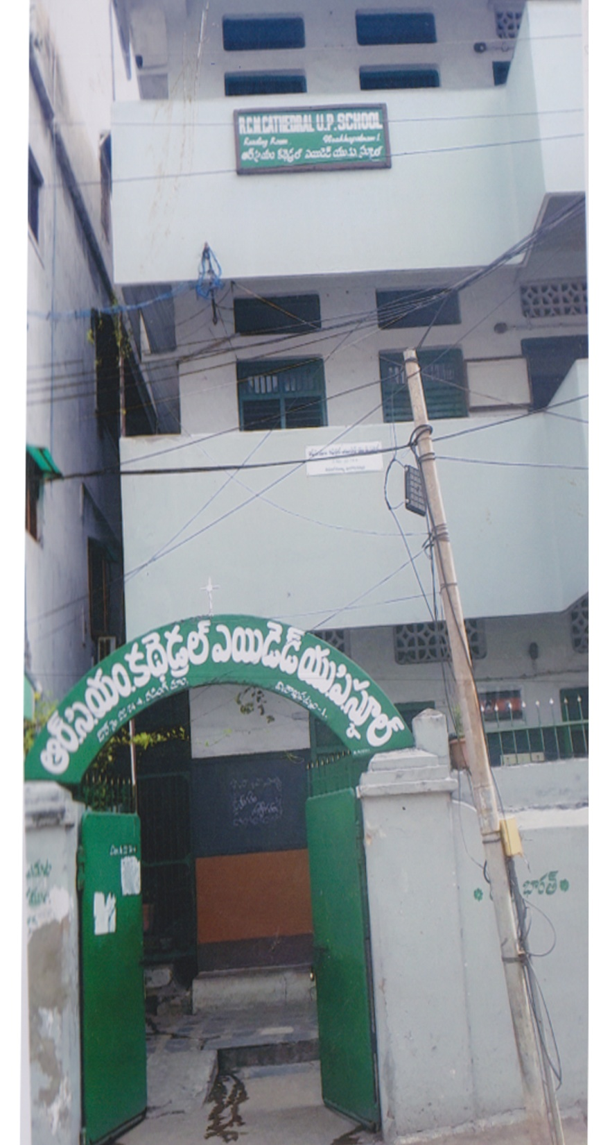
R. C. M. CATHEDRAL U.P SCHOOL READING ROOM VISAKHAPATNAM
ACTIVITIES
2013 - 2018

Slide 3
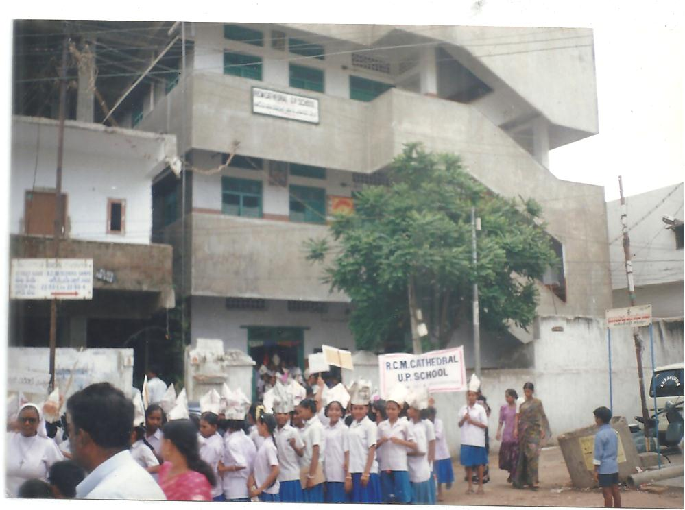
On 17/6/2013 rally was held about the awareness of ‘’Dengue fever’’. Children went around the places, telling the people to keep the places clean

Slide 4
PLANTATION
Creating awareness to the people about the pollution
which is caused due to the cutting of the plants. Slogans were sung by the students. It was held on 14th July 2013

Slide 5
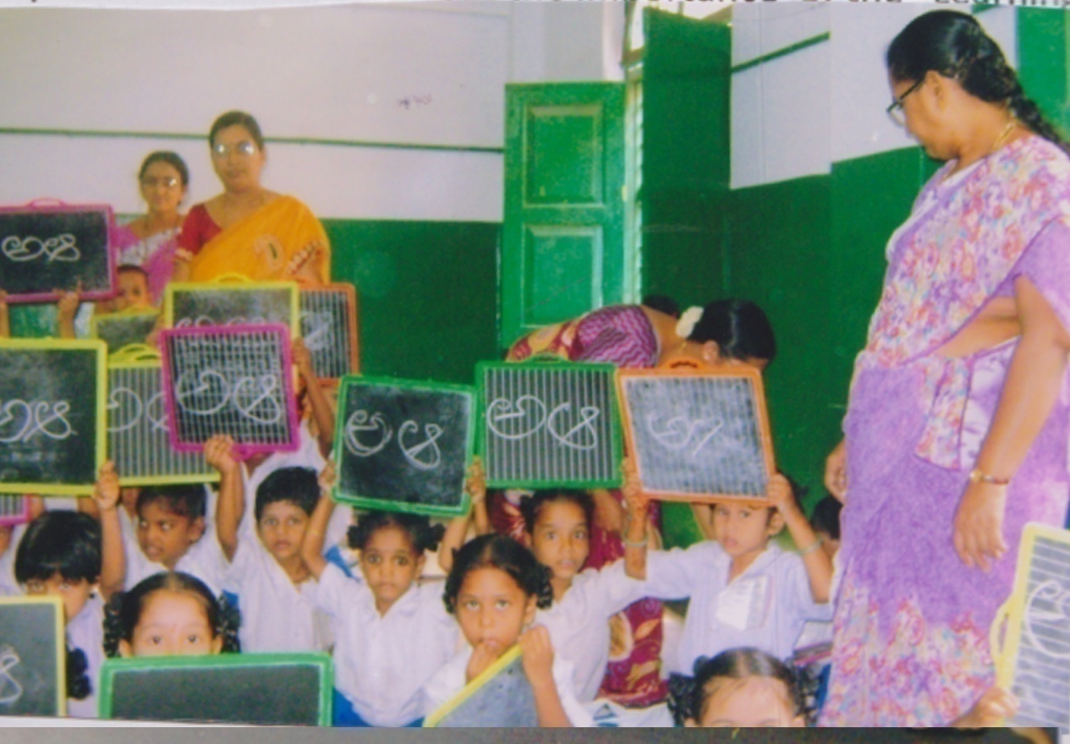
AKSHARABHYASHAM
Date:25-09-2013
Participants: 1st & 2nd students
About: The importance of the “Learning” spoken by Class teachers smt. Jacinta, Smt. Fatima & Smt. Vijaya.

Slide 6
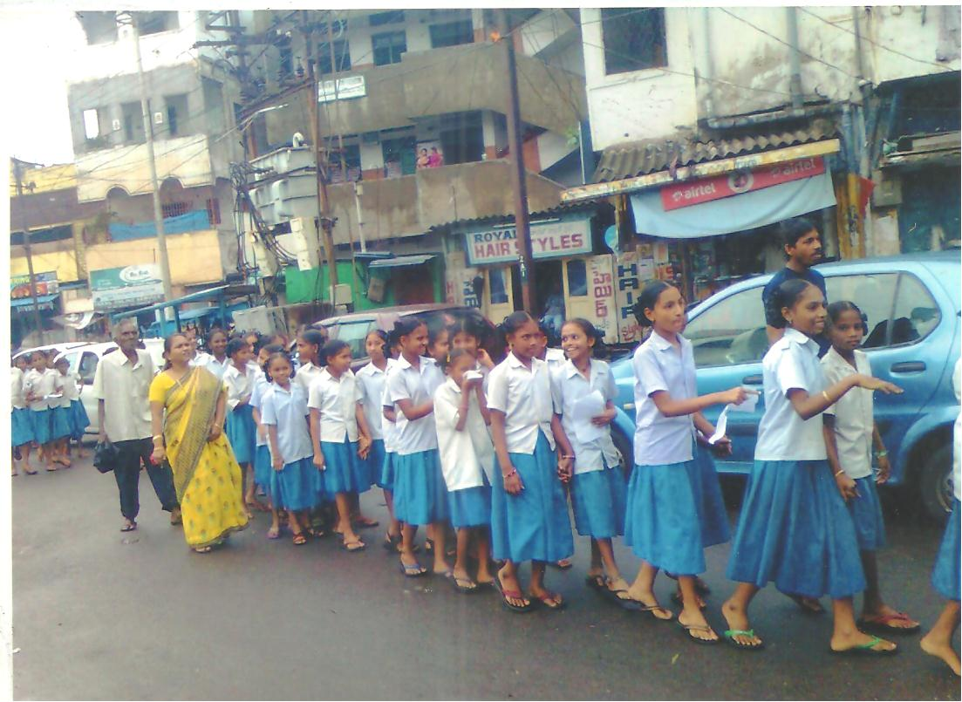
Clean & Green Programme
On 18th December Rally was taken place on the awareness about "Clean and Green Program”/ The students and teachers went near by
Places. With slogans they told the people to plant the plants

Slide 7
“Nutrition” program
Organized on 10th August 2014 at School premises.
The teachers taught the children about the food wastage.
Some of the teachers served the food for the children.

Slide 8
Quiz Competition
A quiz competition was held for the students on 23rd September 2014 regarding
the “use of the library books”.Nowadays everyone is addicted to
the mobiles. The use of books is less. |So the children expressed
the importance of the library in theb school

Slide 9
Parents’ Meeting at School
The Parents’ meeting was held in the school on 10th October 2014.
The teacher asked the parents to send their children to school regularly,
the parents are suggested to help their children in doing home works without wasting time.
The teacher told the parents to take care about their children’s study and control the wastage time in watching T.V.

Slide 10
Prize Distribution Program
The Competition on the role play of women was conducted
on 18th November 2014 . The prizes for the winners were distributed by the School Principal.

Slide 11
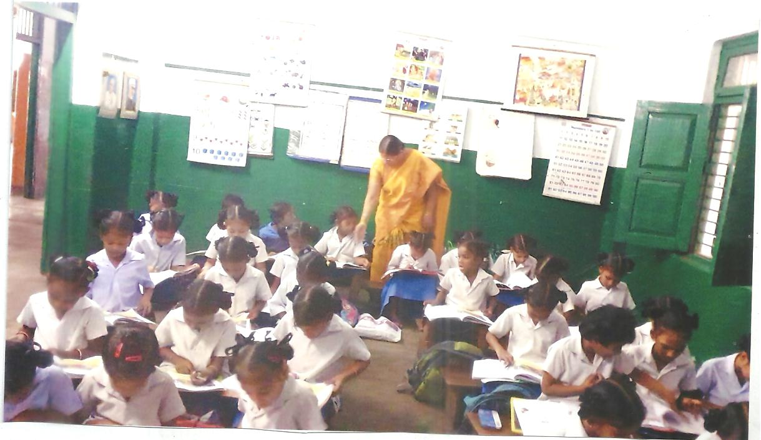
AKSHARABHYASHAM
On 18th July 2015 “Aksharabhasham” program was taken
place for the students. The children were taught about
the importance of the “Learning and Reading”

Slide 12
Use of Drinking Water
On 28th September 2015 there was program on “The use of water”.
The children learned to give importance for using every drop of water

Slide 13
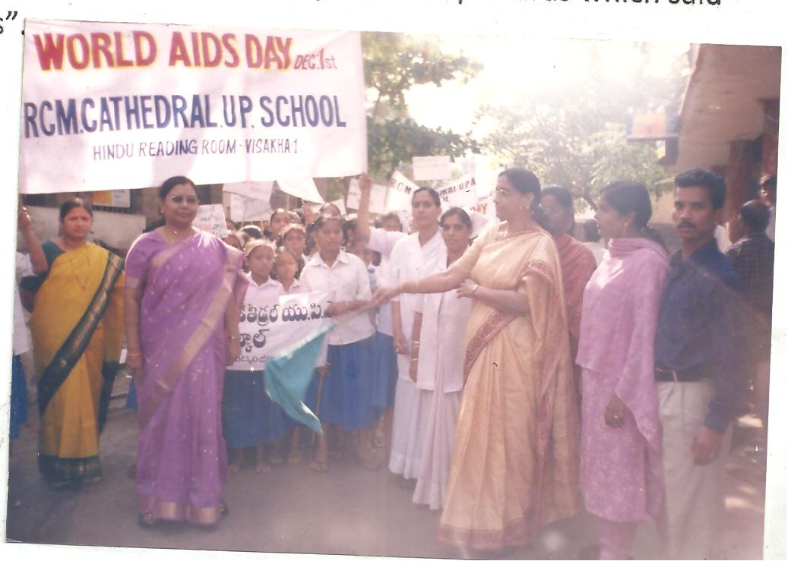
WORLD AIDS DAY CELBERATION
The rally on World Aids Day Celebration was conducted
on 1st December 2015. The people were given awareness about
the HIV/AIDS and preventing measures of Aids.

Slide 14
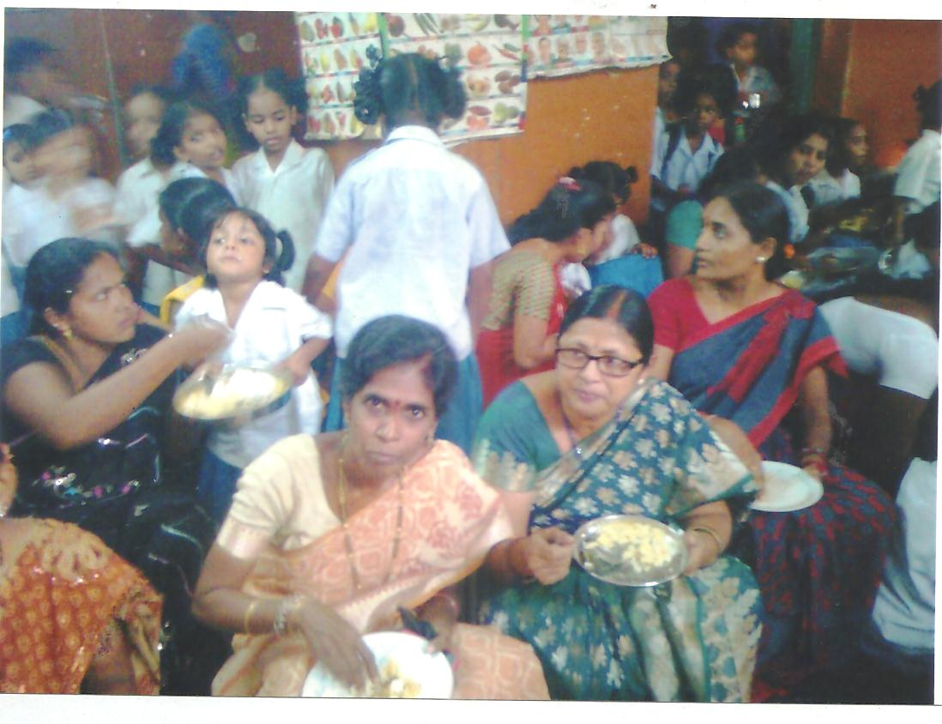
Nutrition & Hygiene
On 26th June 2016 the parents and teachers gathered in the
School campus and discussed about the General Diseases,
Nutrition and Hygiene. The teachers told the parents
to keep their surroundings neat and clean.

Slide 15
“Badi Pillusthindi” Rally was taken place on 19th July 2016. This is an awareness for the children to know about going to school. There should be no drop outs.
On 26th August 2016 the parents meeting was conducted at School Campus. The parents were told to send their children to school daily. The parents should co-operate with teachers.

Slide 16
On 10th December 2016 “YOGA DAY” was declared by the P.M. All the children took active participation. Teachers told that Yoga is good for health.
The Clean and Green Programme was conducted on 16th February 2017. The students gave some cultural programmes about the beauty of the nature.

Slide 17
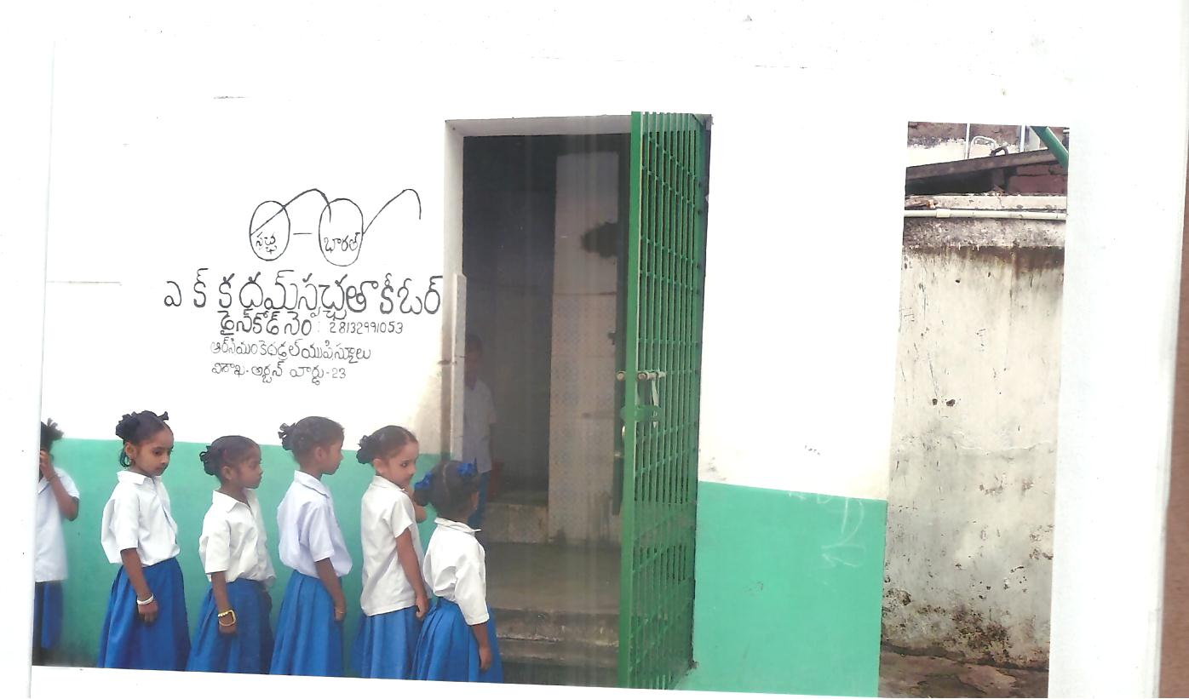
On 25/10/2017 Port Trust Chair Person with the cooperation of SALPG had constructed extra toilets for the students. The Solar System for the entire school building and renovation of teachers toilets was done by them. We are grateful to them.

Slide 18
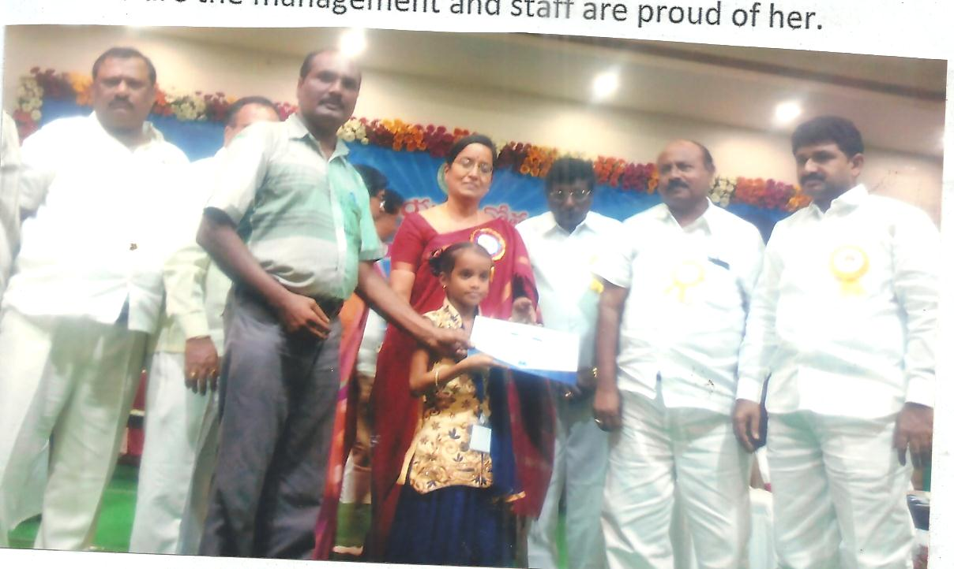
Kum.Nandhini of class 5th got state level first prize in miming on 14th/11/2017. We the management and staff are proud of her.

Slide 19
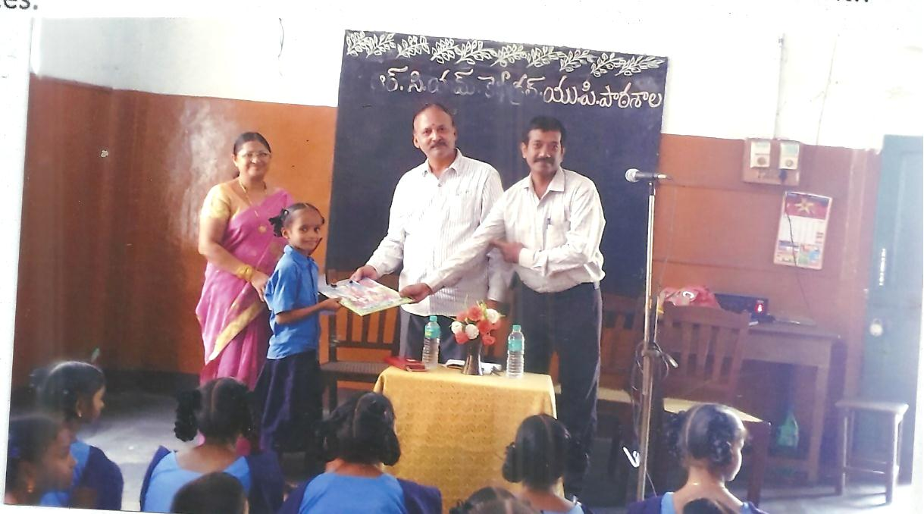
There was a drawing competition was conducted by the urban Library management on 15/6/2018. Some students were appreciated with the prizes.

Slide 20
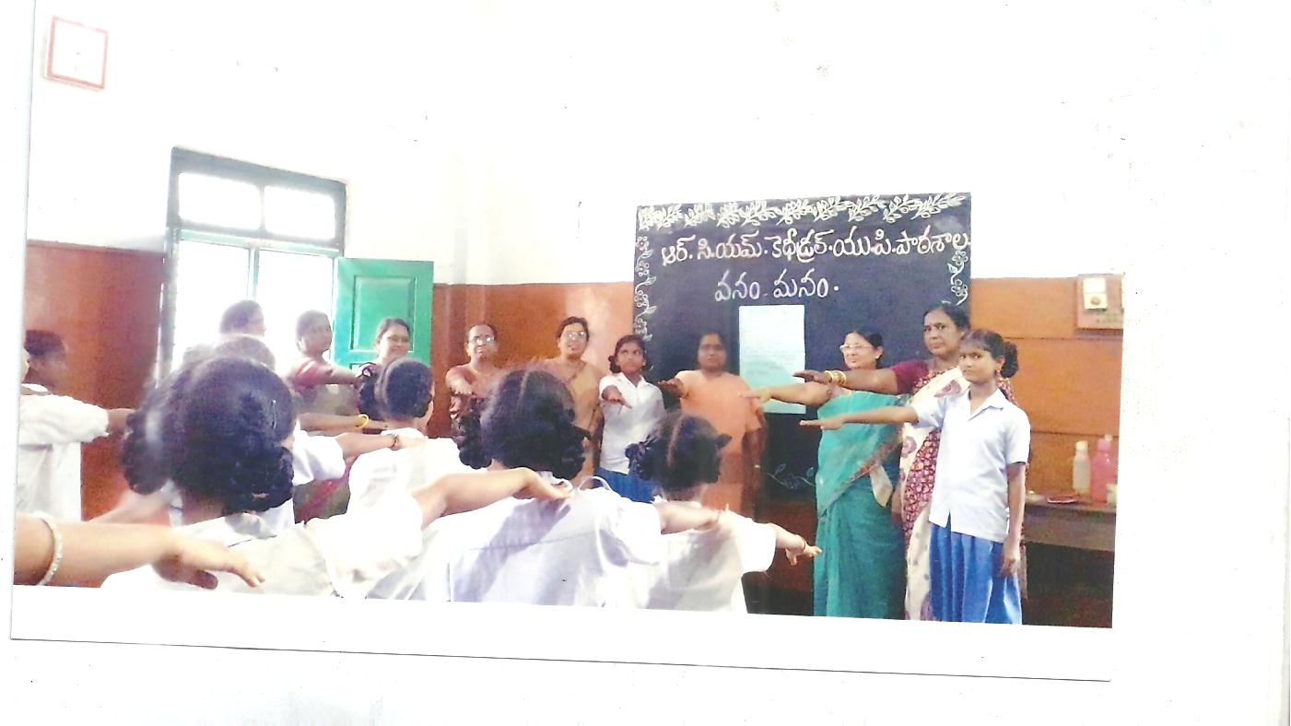
‘’Vanam - Manam’’ pledge was conducted in the school campus by the students and teachers on 12/7/2018. All pledged to take care of the trees and to plant the trees.

Slide 21
Parents’ meeting was taken place on 21\7\2018. Teachers spoke to the parents that parents also should spend time with their children to develop the moral values.
Text books were distributed for the students on 25/7/2018. Children were taught the importance of the books, not to tear and misuse it.

Slide 22
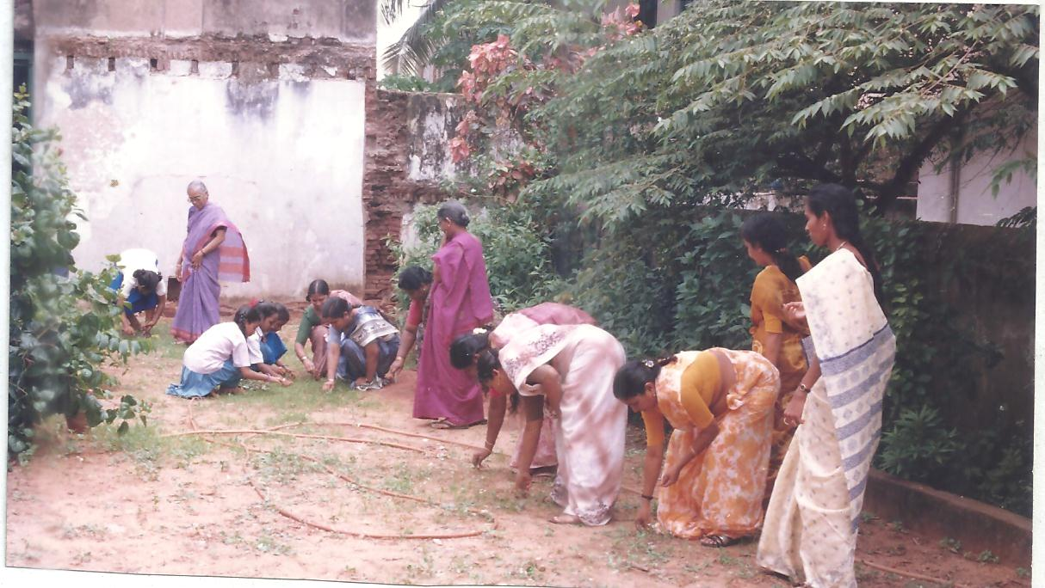
As a part of ‘’Clean and Green’’ program on 11/8/2018. Teachers and students joined in near by places to clean and to keep the places tidy to avoid the sickness.

Slide 23
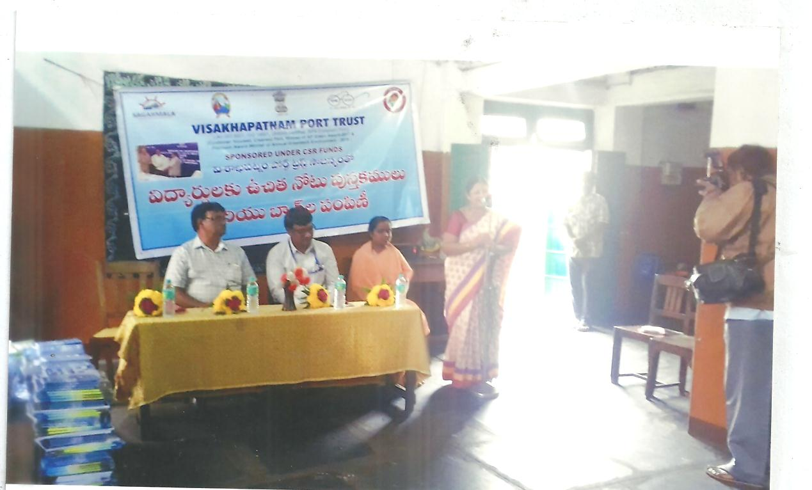
Port Trust people distributed the note books for the students on 25\8\2018. We are grateful for their generous service towards our poor students.

Slide 24
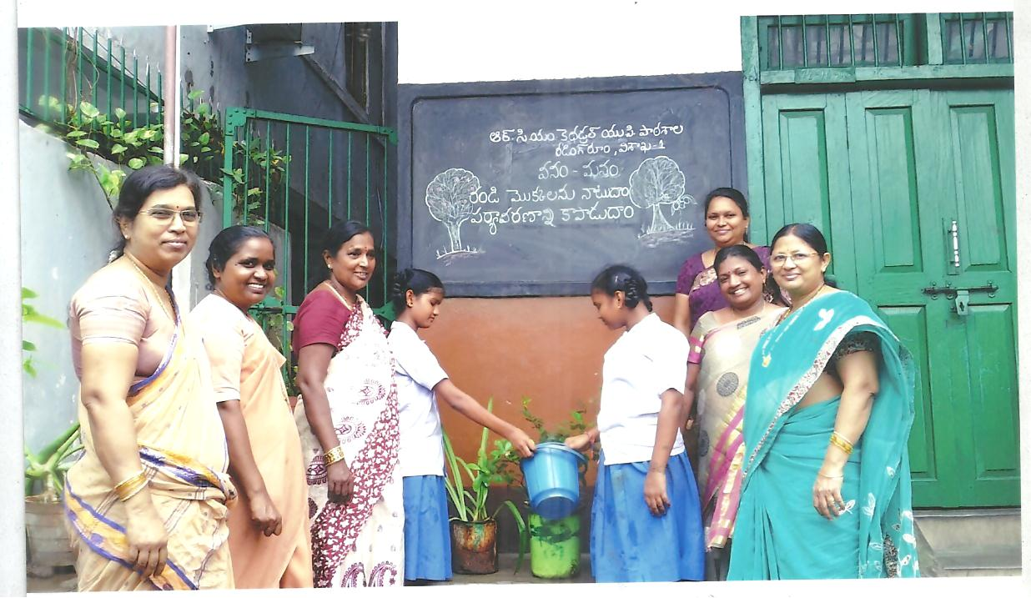
On 3/9/2018 ‘’Vanam Manam’’ program was conducted in the school. Teachers and students planted the small plants. Burakadha was played infront of the school to give awareness about dengue fever.

Slide 25
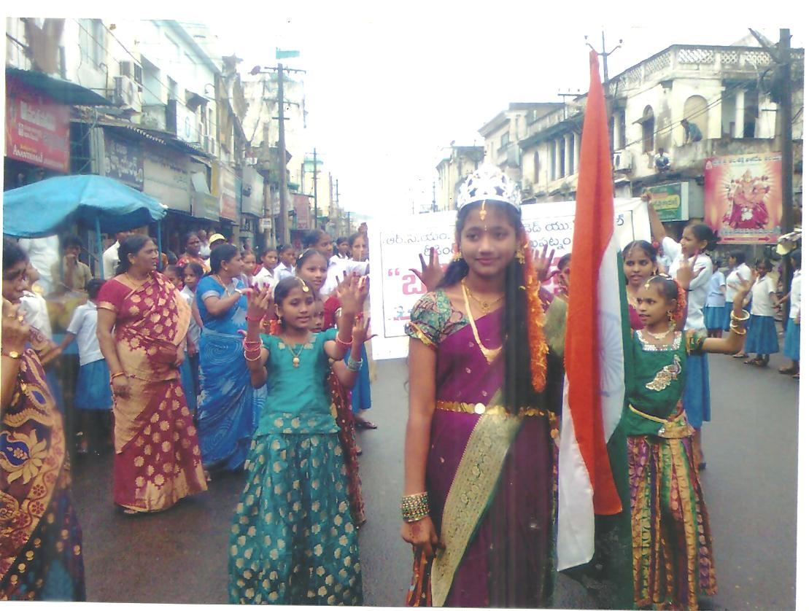
On 3rd October 2018 Students went around the places with cultural activities telling about the greatness of our national leaders .

Slide 26
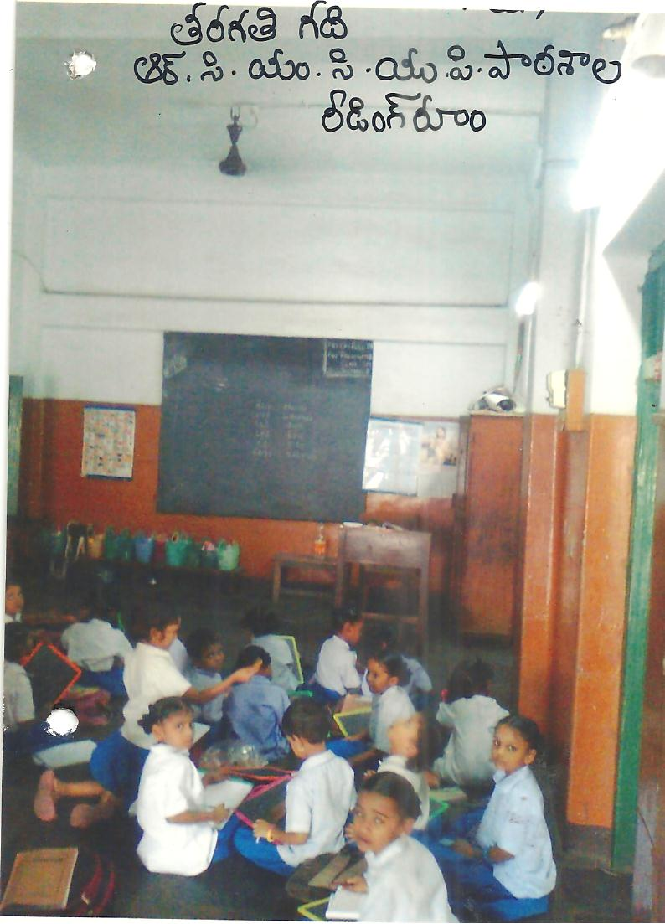
November 14th as Children’s Day Quiz competition was conducted for the students

Slide 27
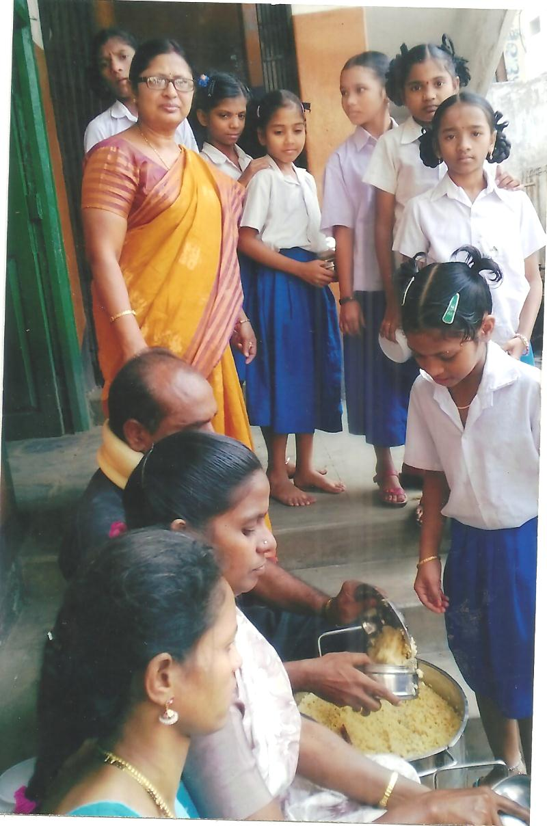
On 16th November 2018 Children were served food in line as part of the Discipline

