Slide 2
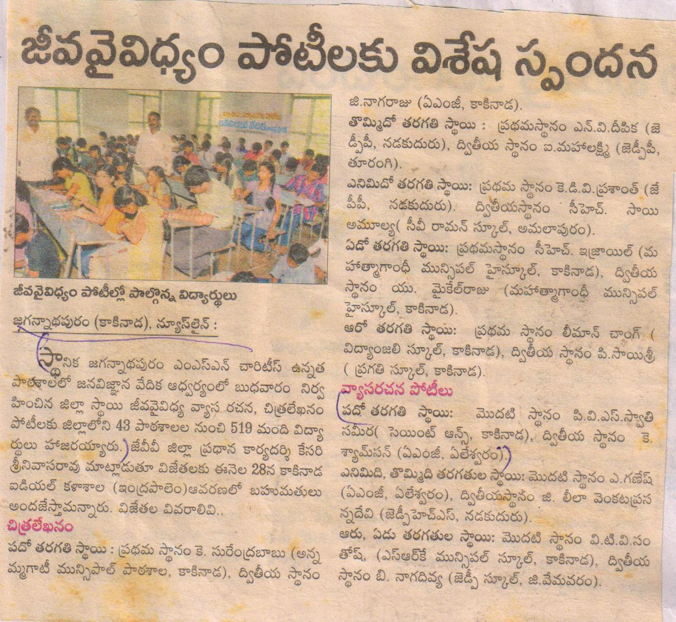
2013-14
Co-Curricular Activities
The Students of St. Ann’s Aided Girls High School had Participated in Easy Writing and Painting Competitions conducted by Jana Vignana Vedika at M.S.N.C High School, Kakinada among 519 students participated in this competition from 43 Schools Kum. P.V. Swathi Sameera of our school won 1st Prize.

Slide 3
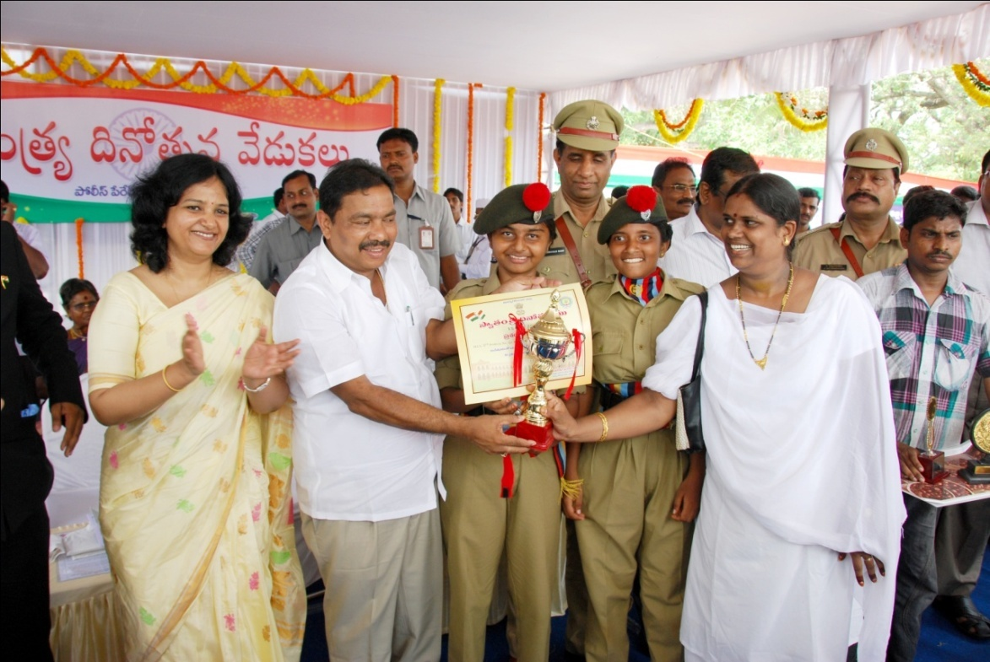
NCC
NCC Students of St. Ann’s Aided Girls High School banged prizes 6 times at the eve of Republic day Celebrations. NCC 3rd A.P. Girls Battalion March past wing won 2nd Place on 26.01.14. and received the prize through Neethu Prasad District Collector of East Godavari Dist. The National Integration programme wa conducted by the District Collector on 13.03.13. students of St. Ann’s Aided Girls High School had participated in Cultural Activities and won the first Prize.

Slide 4
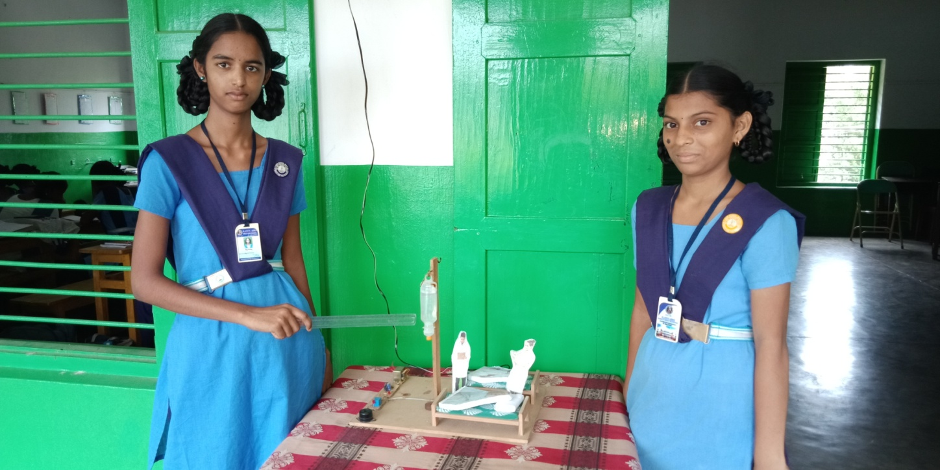
Inspire Awards - 2013-14.
Inspire Awards 2013 Programme was held at A.M.G. School Kakinada The Project “Cyline leval Indicater“ presented by our student won Second Prize.

Slide 5
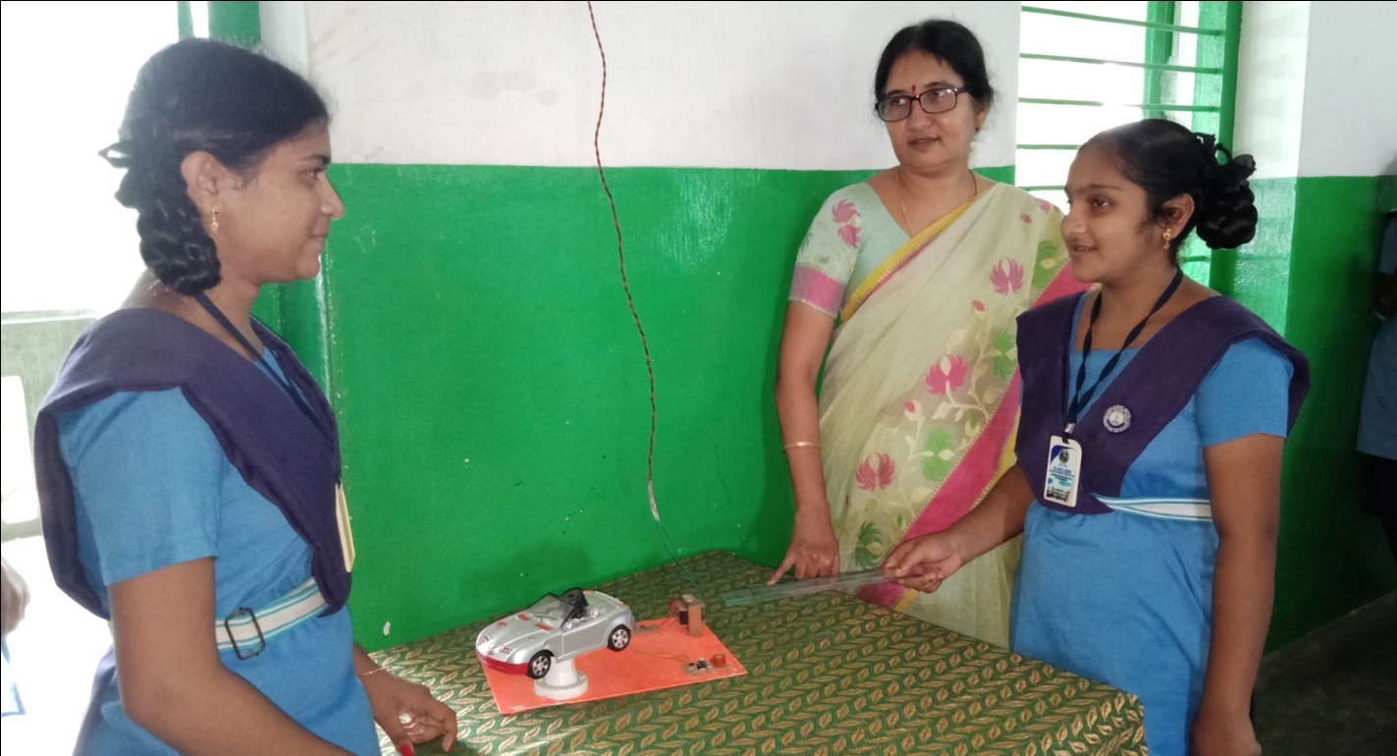
2014-15
Inspire Awards.
Inspire Awards 2014 Programme was held at A.M.G. School Kakinada from 29.07.14 to 31.07.14. 650 Projects were displayed. The Project High Level “Alchohal Sensor “ presented by our student A. Charishma won first Prize and Qualified for State Level.

Slide 6
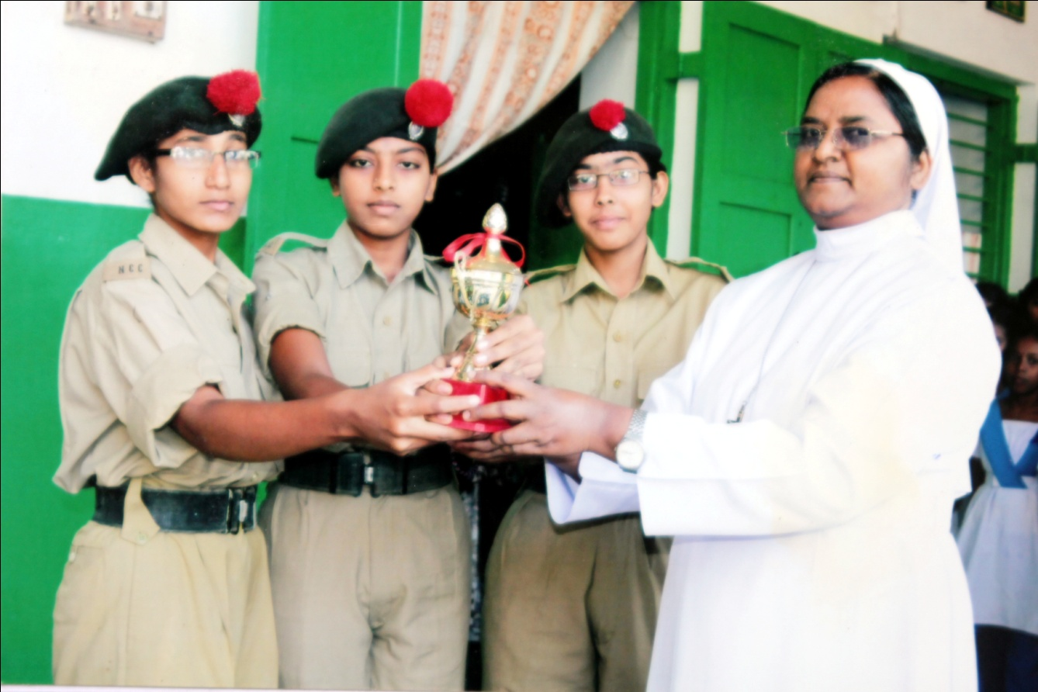
NCC Achievements.
All India Trikking Competitions were held in Darzling on 16.11.2014. In this camp K. Vinnela IX. Class are selected and Participated. They exhibited Their talent on 80km Trikking.

Slide 7
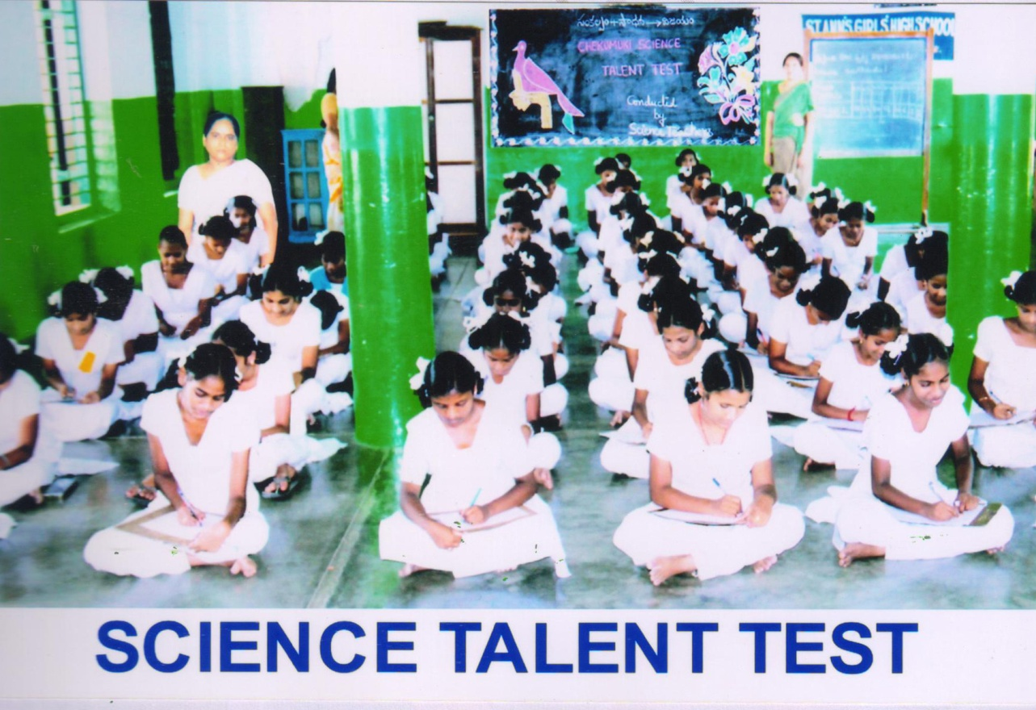
Chekumuki Talent Test.
Chekumuki Science Talent Test was held Meclaurin High School on 18.11.14. Our Students of St. Ann’s Aided Girls High School won First Prize and qualified for the District Level Competition.

Slide 8
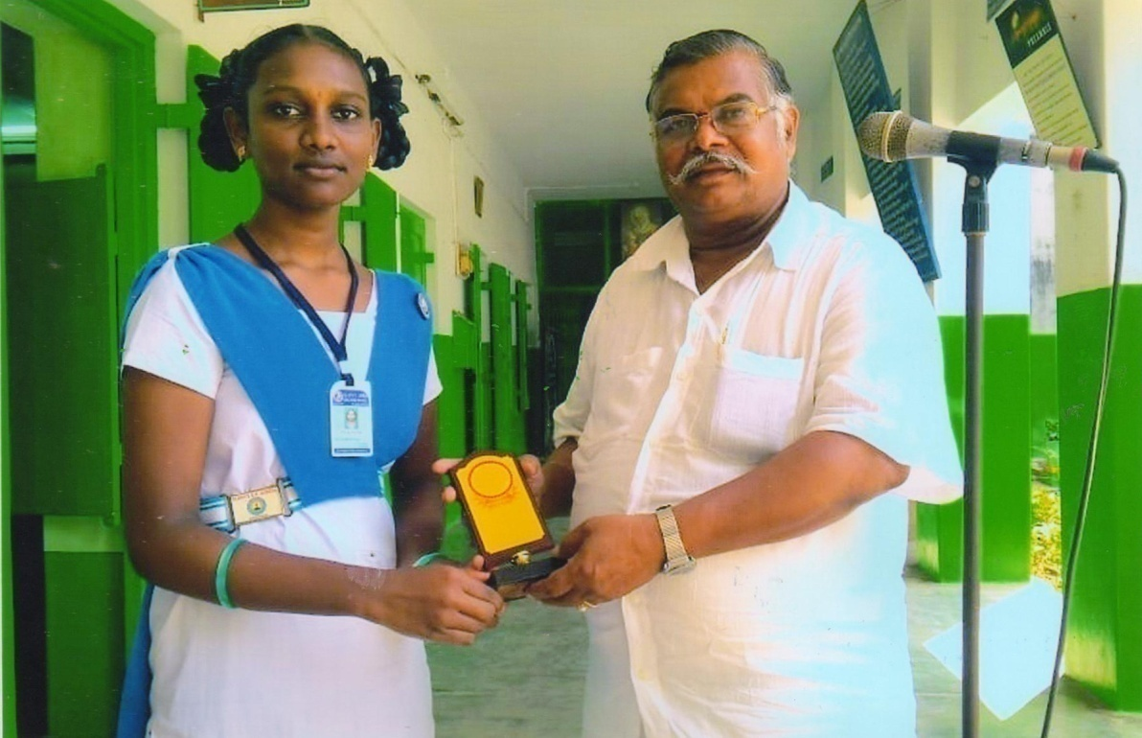
2015-16
Hand Writing Competition.
Hand Writing competitions were held by Rotary Club, Blood Bank on 22.10.15. St. Ann’s Aided Girls High School Students Participated for this competition. X. class student Kumari Devi Priyanka won 2nd Prize, K. Durga won 3rd Prize, B. Raju Ganga won 3rd Prize.
Sloka’s reading competition conducted by Sri Venkateswara Swamy temple J.K.Pur. Kakinada on 08.11.15. Kum. K. Syamala Devi won 3rd Prize.

Slide 9
Debate Competitions.
Debate Competitions were held by Kakinada Building Society on 14.11.15. Our IX.Class student Kum. Ch. Ramani won 1st Prize and P. Nirmala won 5th Prize.

Slide 10
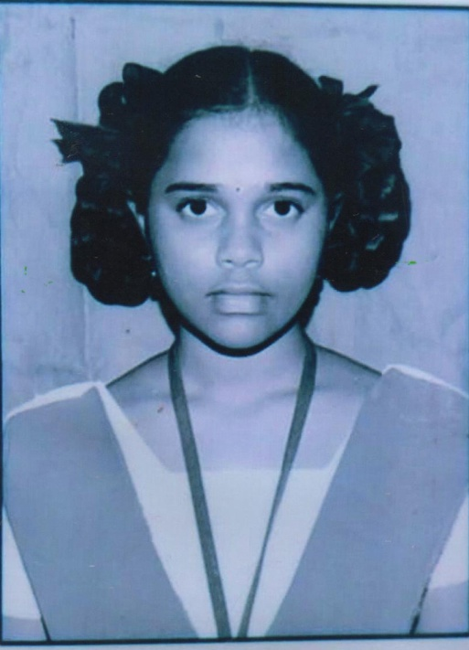
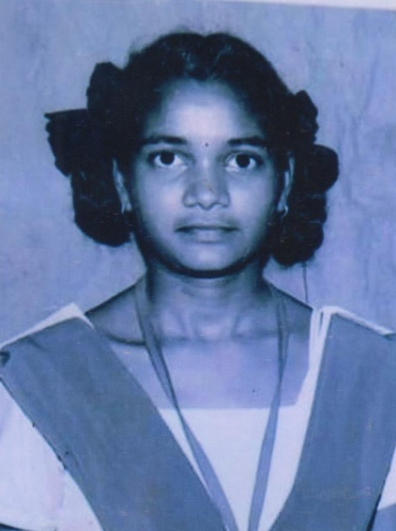
2016-17
SSC Public Examination – 2016.
In SSC Public Examination March 2016. 166 Students from St. Ann’s Aided Girls High School have appeared 100% result was secured.
Kumari. Gopi Mounika Devi, Kumari. Polavarapu Kiranmayi, Kumari. Pemmadi sai Nandini, Secured 9.7 grade Points and stood in First Place.

Slide 11
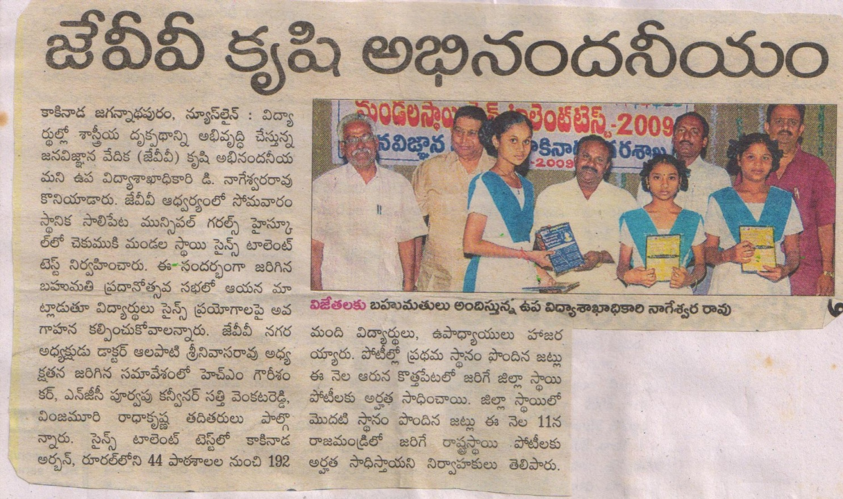
Chekumuki Science Talent Test.
Mandal level Chekumuki Tallent Test 2016 was conducted on 19.11.16. At Ashram Public School In this School level test 450 students were Participated. Telugu Medium urban range in senior level secured. We got 4th place and Juniors 3rd place in Junior level range.

Slide 12
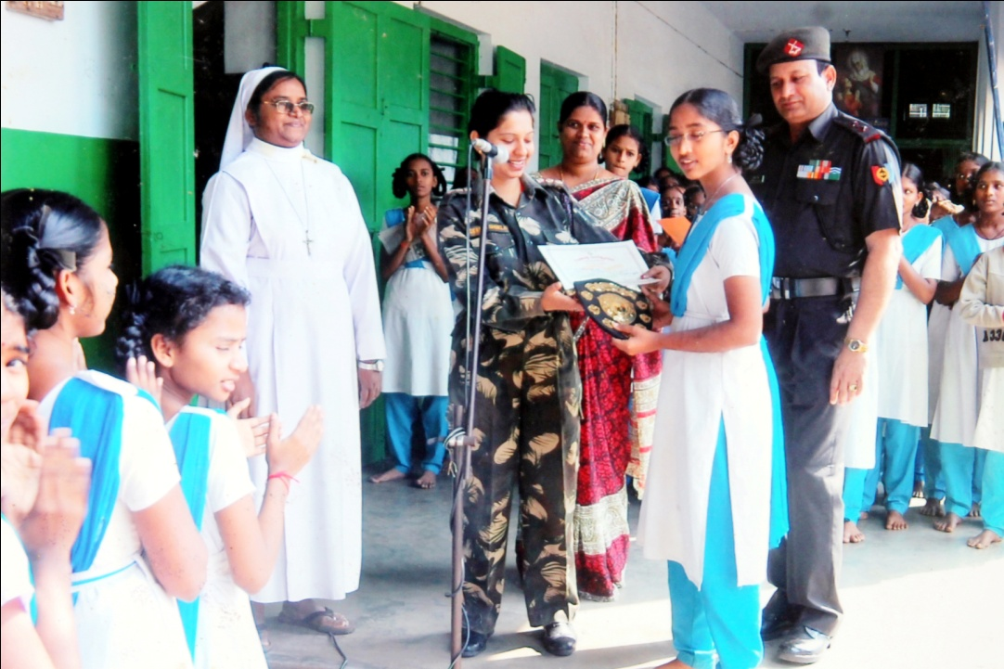
Khelo India.
Khelo India Programme conducted in JNTU stadium on 30.11.2016. different school students participated. St. Ann’s aided Girls High School students participated in different sports and won prizes and medals.
400 Mtrs Relay VI th Class V. Syamala
VII th Class P. Bhavani
P. Mary
IX th Class B. sai Karuna.
Won four silver medals.
In juniors Long Jump V. Syamala 6th class student won 3rd Prize.
100 Mtrs relay 7th th class P. Mary won Gold medal.
9th class student B. Sai Karuna won Gold medal in Long Jump. and won 3rd place in high jump.
V. VaraPradha, T. sada, V. Renuka, V Ome Kavya, O. Satya, K. Lidiya, K. Mounika, P.Devi, P. Bhulakshmi, S. Saty won First prize in Kabaddi U-14.

Slide 13
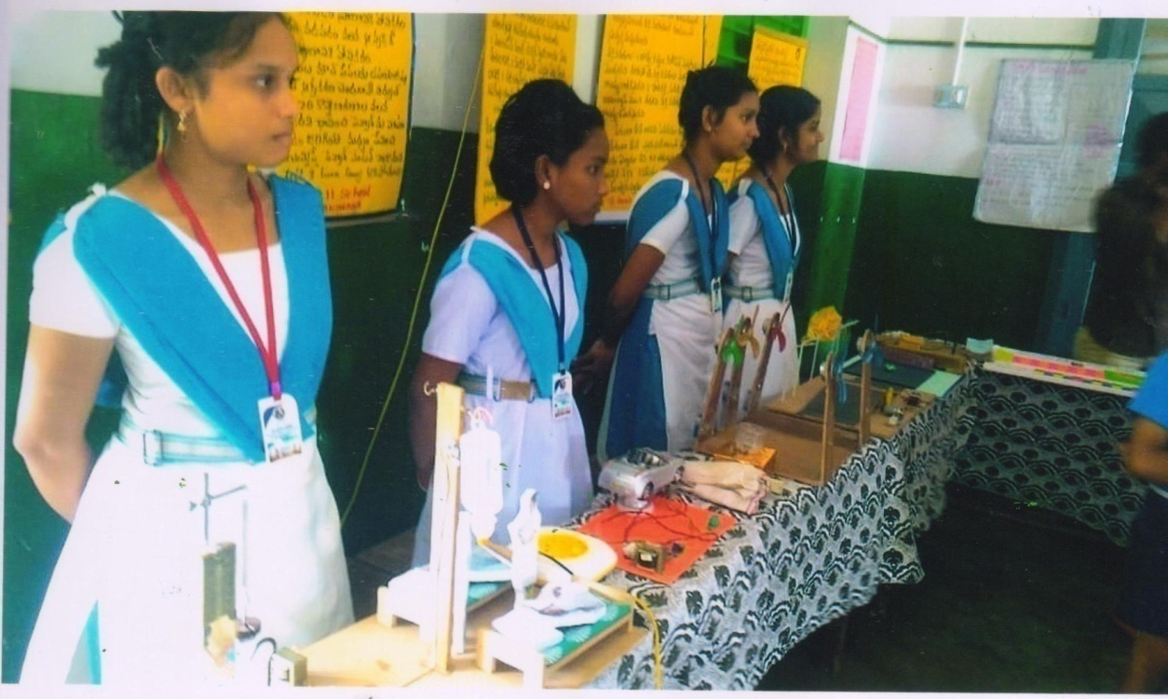
Chekumuki Science Sambaralu.
Chekumuki Science Sambaralu were held by Jana Vignana Vedika in Aditya Public School J.K. Pur. on 10.12.16. On this occasion different Science events were conducted.
Our students of St. Ann’s Aided Girls High School Kum. Ch. Sri Ramani won 1st place in Essay writing and Kum. Gnana Nageswari 9th Class secured appreciation prize in Drawing.

Slide 14
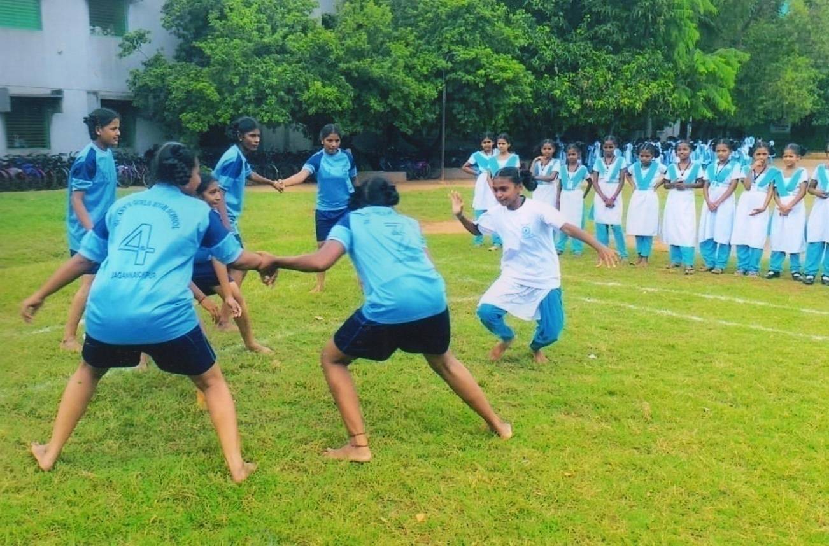
State Level Participation.
Mandal and District level Kabadi competition was conducted in JNTU Grounds on 24.02.17. St. Ann’s Aided Girls High School were students participated in that competition and Kum. V. Varaparada 9th class selected for State level competition and participated at Vizayanagaram on 26.02.17.

Slide 15
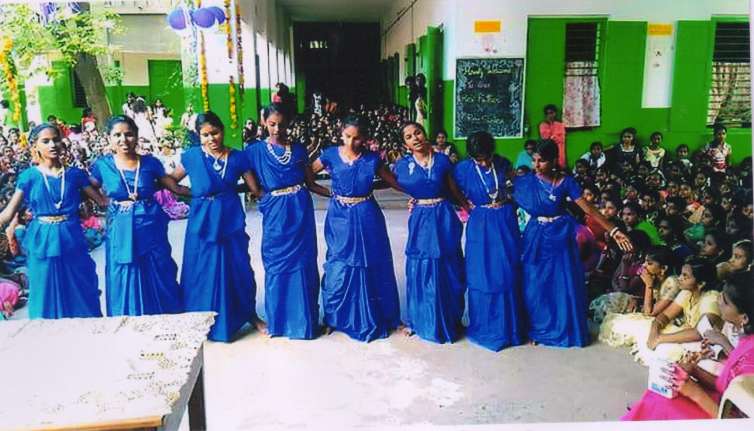
Kriya Students Festival.
Kriya Students Festival programme was held in JNTU Grounds on 25.02.17. St. Ann’s Aided Girls High School students were Participated in different events and showed their talents. In debateCh. Sri Ramani, Ch. Raja rajeswari won 1st prizes and also won 1st prize in Janapada Nrutyam in senior’s wing.

Slide 16
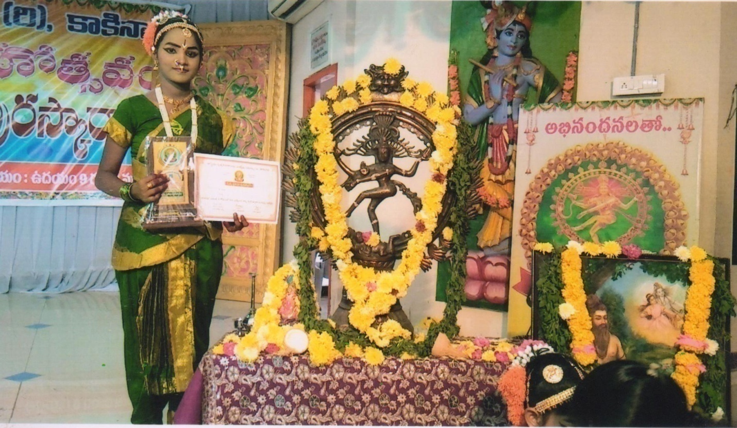
Wonder Book of Records.
Kuchipudi dance competition conducted by Sri Jyothi Nrutya Kala Niketan on 25.02.17. St. Ann’s Aided Girls High School student Kum. Nagedi Kusuma 8th class Participated in this occasion and won recorded in Inter National Wonder Book of Records.

Slide 17
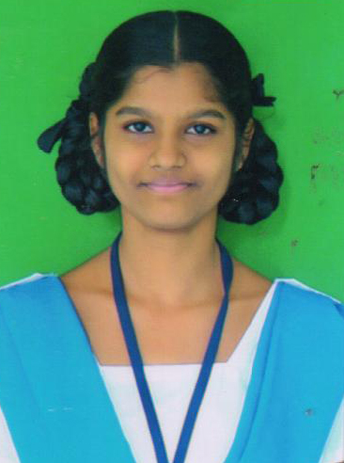
2017-18
Amaraveerula Dinothsavam
In memory of “Police Amaraveerula Dinothsavam” Essay writing competition was conducted by the police department on 21st competition were held our 10th class student Kum. Varipilli Navya won 1st Prize in Essay Writing Competition.

Slide 18
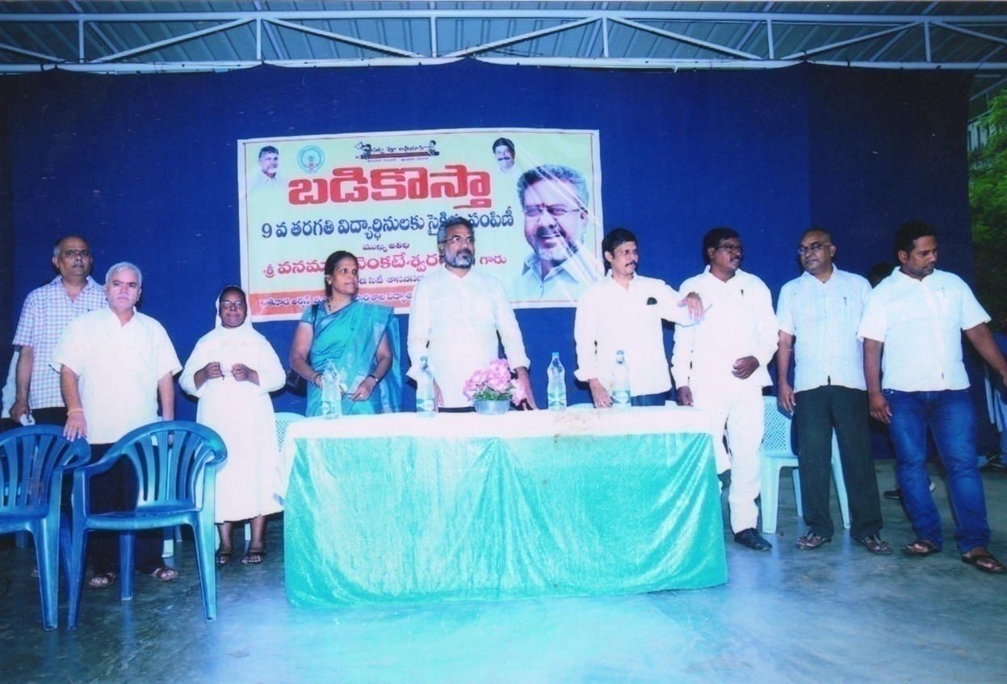
“Badipilustondi - Badikosta”.
Cycle Distribution – Cycle raly programme.
“Badipilusthondi - Badikosta” programme was conducted in St. Ann’s Aided Girls High School on 14.06.17. at 10.A.M. on this occasion free cycle were distributed to 9th class girl students.

Slide 19
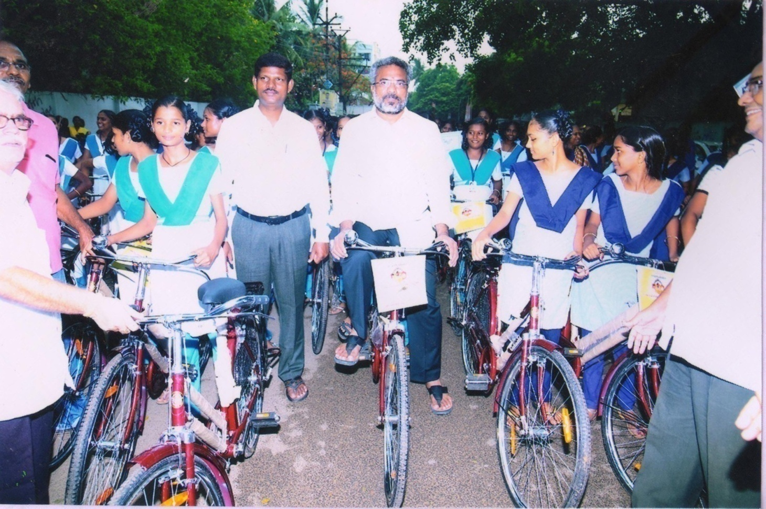
This Programme was organized by the St. Ann’s Aided Girls High School. Smt. P. Vani Geetha Kumari Kakinada Urban D.I. Kakinada M.L.A Sri Vanamadi Kondababu Garu, E.G.Dt. D.E.O Sri Abraham garu, School complx Headmistresa, Parents were attended on this occasion government-183 free cycles distributed to our 9th class students. Higher officers advised to the students to utilize the facilities in all aspects. after this programme cycle raly was organized.

Slide 20
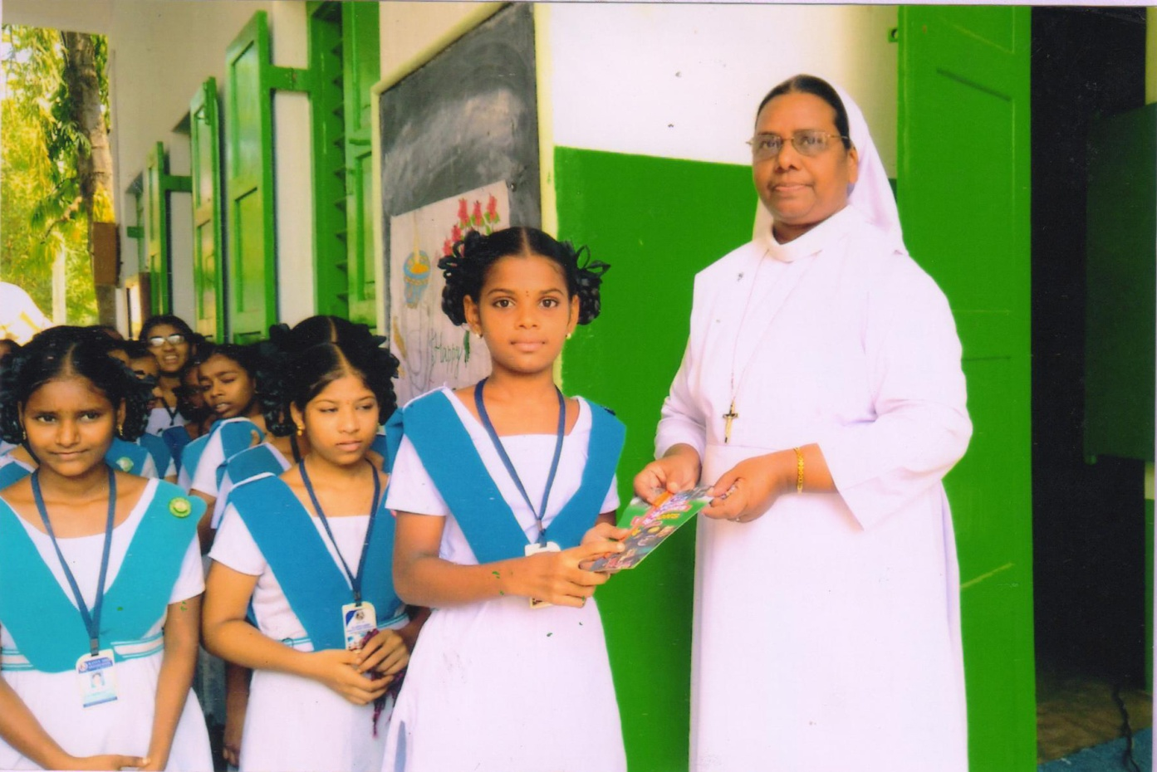
Chekumuki Science Talent Test.
Mandal level Chekumuki Science Telent Test was held on 17.07.17. In the competition 72 schools were participated. The students of St. Ann’s Aided Girls High School won 1st prize and qualified for State Level.

Slide 21
Vaccination Programme.
Vaccination Programme was arranged in St. Ann’s Aided Girls High School, Kakinada on 01.08.17. Four teams @3 persons attended from Health Department on 31.07.2017 our school H.M rev. Sr. P. Nirmala Jyothi conducted parents meeting and explained about this programme, she advised them to take care from small pox, chicken pox, and utilized the vaccination programme. On that day itself 98% students were vaccinated and the remains students were vaccinated on 04.08.17. 100% students participated in this programme.

Slide 22
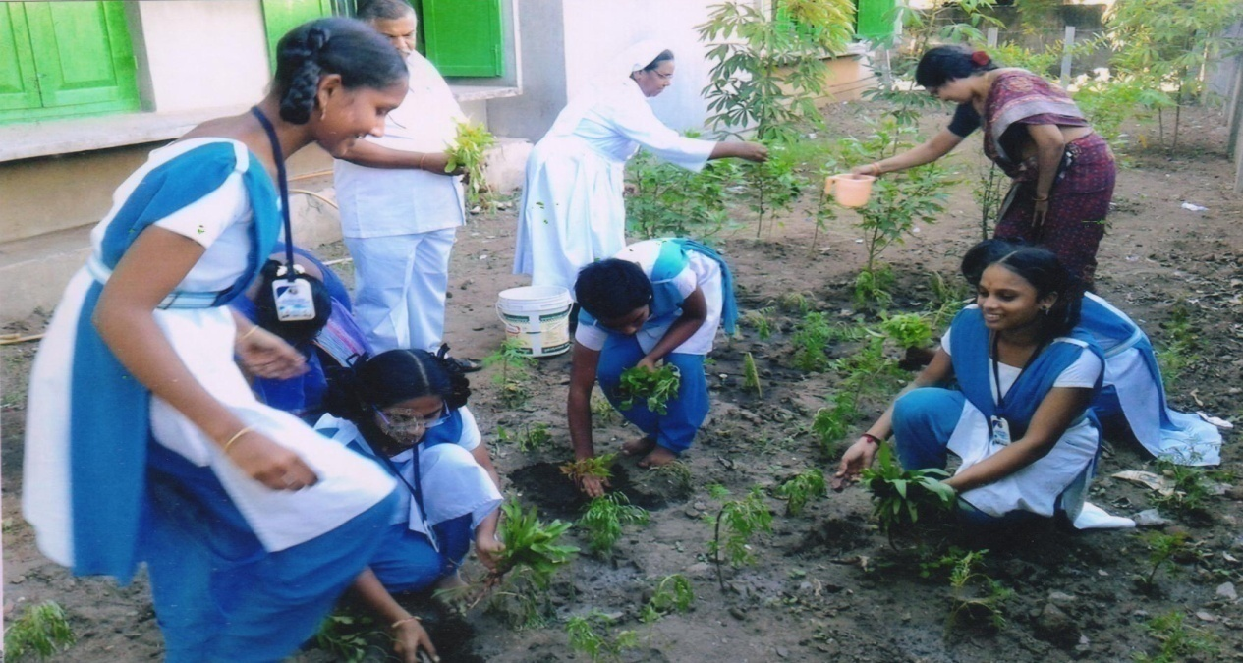
Swatcha Vidyalaya Vuthsavalu.
“Swatchha vidyalaya vuthsavalu” were conducted by our H.M Rev. Sr. P. Nirmala Jyothi from 01.09.017. to 05.09.17. In St. Ann’s Aided Girls High School.
She was Conducted parents meeting on 01.09.17. and explained about this programme “Swatchha Oath” taken by students , As per the government orders, day wise programmes were conducted, They were such as Vanamahotsavam, Plantation, Cleaning, of class rooms, Play grounds, disposing the old and waste material and also conducted and different competitions about “Swatchhata essay writing, Drawing, Debate, Painting. Smt.P.Vani Geetha Kumari Deputy Inspector of Schools Inspected our programme and appreciated our H.M Rev. Sr. P. Nirmala Jyothi. And distributed the prizes to the winners.

Slide 23
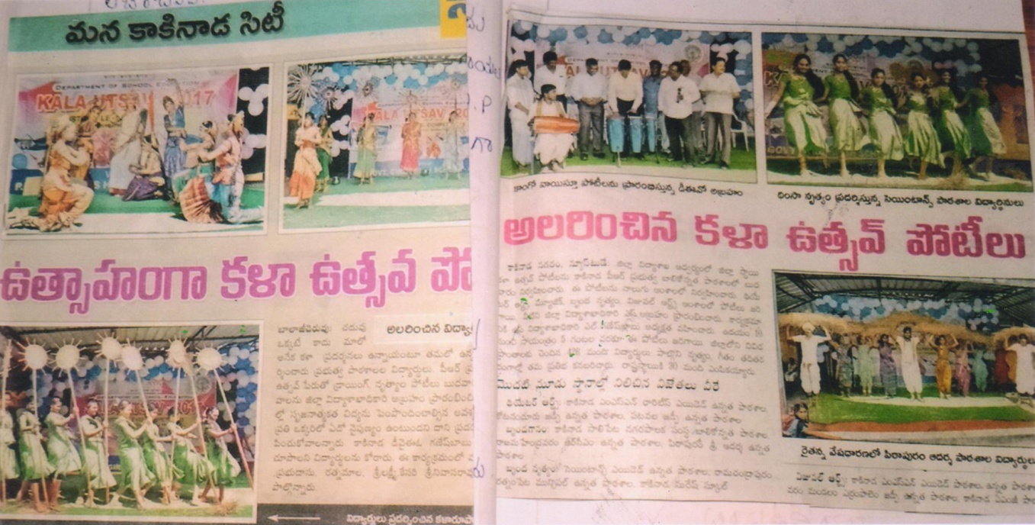
Kala Utsavalu.
Our District Educational Department of E.G.Dist. conducted the competition of ” Kala Utsavalu” at P.R Girls High School on 01.11.2017. This Programme was conducted by the District Educational officer Sri. Abraham Garu and Deputy Educational Officer Sri. L. GaneshBabu Garu. In that Competition St. Ann’s Aided Girls High School won 1st prize in “Brunda Nrutyam” and selected for the National level.

Slide 24
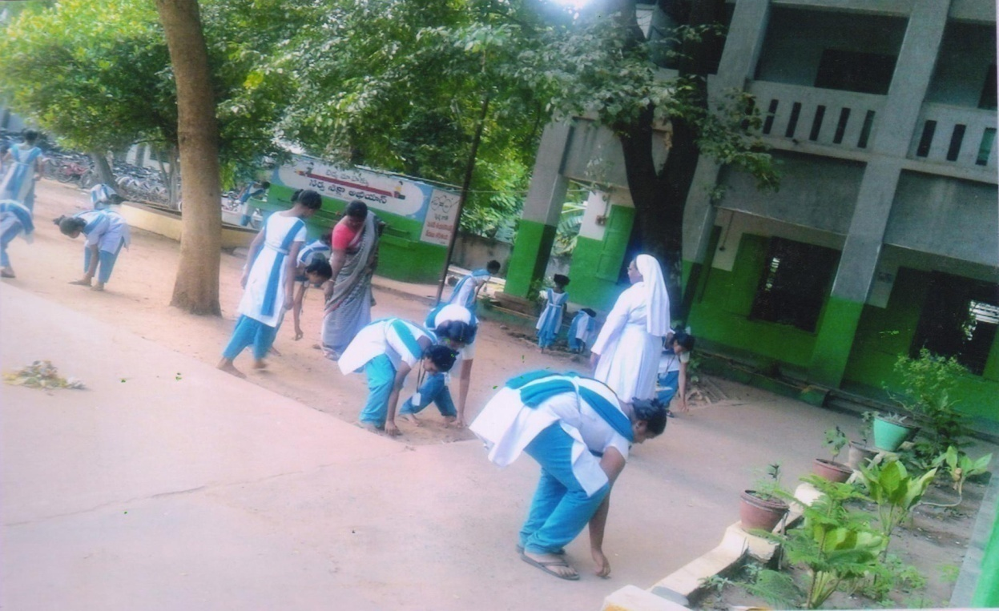
Swatch Bharat.
On the Occasion of “Swatch Vidyalaya Utsavalu” Competition were held by the Forest Department. In this competition P. Kanaka Mahalakshmi 10th class student won second prize in Essay writing Kum. S. Sravya 10th class student won 1st prize in Painting competition they received the prizes on 04.11.17. at Nagaravanam rajamundry by Respected M.P Sri.Nimmakayala China Rajappa and Respected M.P. Sri Murali Mohan.

Slide 25
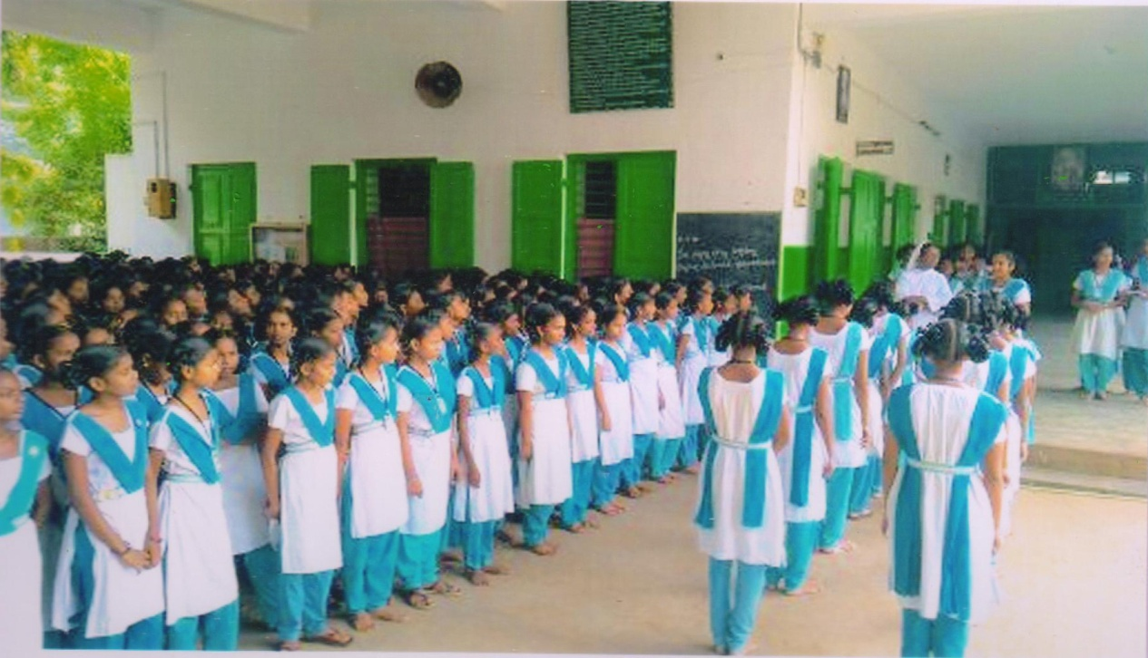
Annual Inspection.
Annual Inspection on 16.11.17 annual inspection was conducted by Educational Dept. of E.G.Dist. Kakinada. in St. Ann’ s Aided Girls High School Dy.E.O Sri. Ganesh Babu garu, and High School Gazetted Head masters were inspected. As per the procedure they arrived at 9.00 A.M and Inspected from Assembly to till evening at 7.30 P.M. They observed class wise and subject wise teachers. 2 students they verified all the records, registers maintained by the school at 5.00 P.M. Mass Drill, Pyramids, Cultural programmes were performed by the students and observed under the president ship of Sri. Ganesh Babu garu, The Staff meeting was conducted and the panel Inspectors expressed their openion about the school and also gave their suggestions to keep up the reputation of the school.It is memorable event.

Slide 26
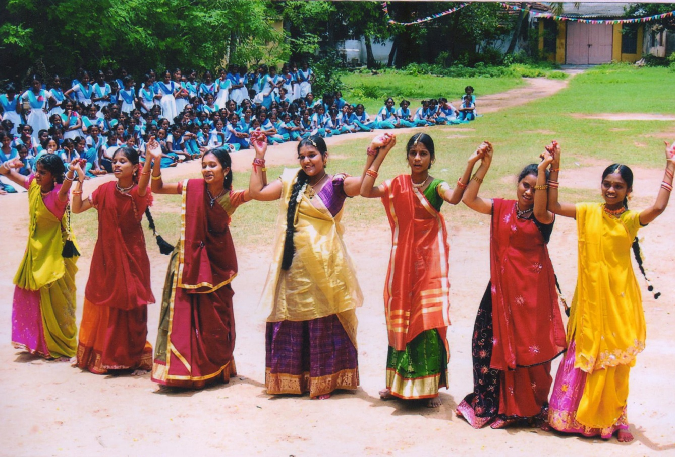
Kala Utsavalu.
State level “Kala Utsavalu” Programme was held at Guntur on 23.11.17. The students of St. Ann’s Aided Girls High School won 2nd prize.

Slide 27
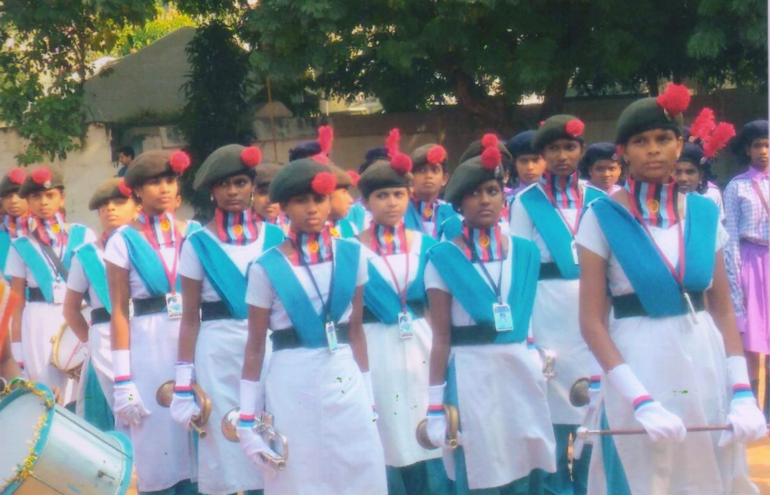
State Level Drum Beat Competition.
State level Drum Beat competitions were held in Eluru n 02.12.17. And won Third prize through we have no Instruments were able to get the instruments with the help of our Sacred Heart High School Visakhapatnam and got the prize.

Slide 28
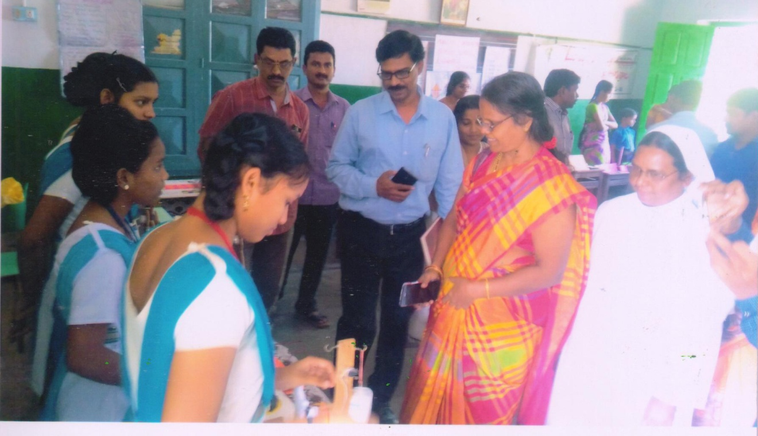
T.L.M Mela.
Teaching Learning Material Mela conducted by Deputy Inspector of Schools Urban range in St. Ann’s Aided girls High School on 06.12.18. The project were presented by the students of St. Ann’s Aided girls High School won the 1st prize in school level and won 3rd prize in Mandal Level.

Slide 29
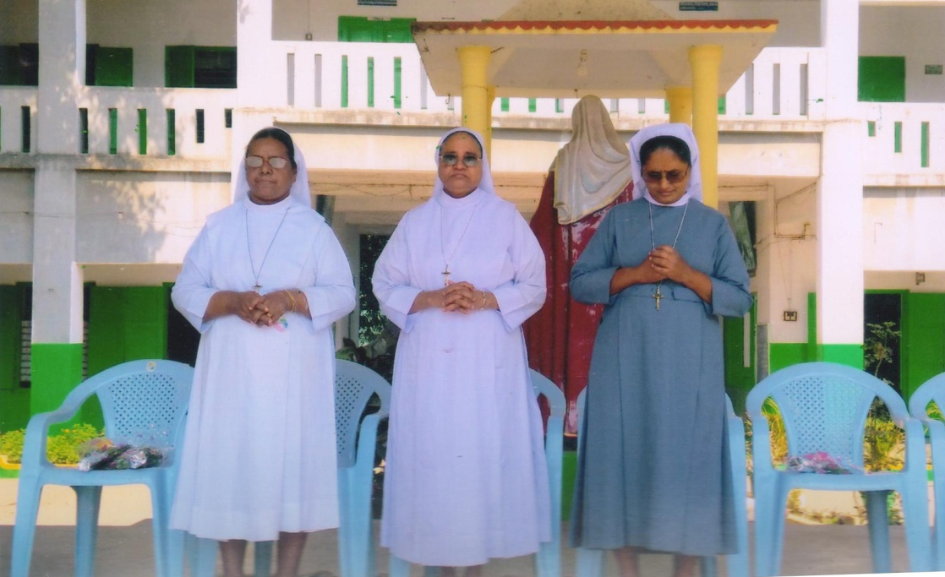
Management Inspections
Management Inspections on held 09.01.08 from St. Joseph’s congregation Rev. Sr. Josphin and Rev. Sr.Vasantha from management side attended for Inspection.
They arrived at 09.00. A.M and Inspected from the assembly to till 1.00 P.M. They observed class wise and subject wise teachers. They gave advised to the students that everyone should maintain discipline and good manners and study well.
The study In the presence of H.M the staff meeting was conducted and them advised proper way of dealing even though roll number is more and we should consider them as our own children god’s blessings are always with us if we work sincerely and dedicatedly. Every teacher should maintain self discipline, should not use cell phones, in teaching lesson and paper correction should be maintained regularly we should adapt punctuality , every student will observe and follow the teacher, so teacher should be the role model.

Slide 30
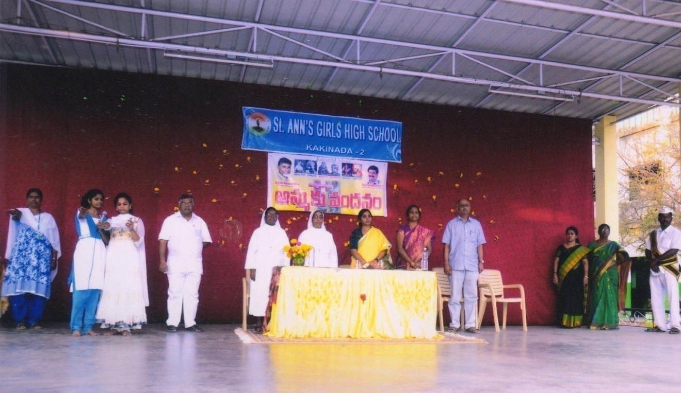
Ammaku Vandanam.
On 22.01.18. Ammaku Vandanam programme grandly conducted under the supervision of Deputy Inspector of schools Smt. P. Vani Geetha Kumari and H.M. Rev. Sr. P. Nirmala Jyothi.
Essay writing, Debate, Drawing, Singing, Poems competition were conducted on the theme of “Mothers Greatness” mothers affection.
Kakinada Urban D.I Smt. P. Vani Geetha Kumari, Dy.E.O, D.E.O and Kakinada Mayor Smt. Sunkara Pavani garu, Complex Headmasters and parents were attended for the programme. All officers advised students to respect and honour their parents, Students performed for Padabhee vandanam to their mothers. This programme was looked very beautifully and heart touching one every one taken up by the programme and appreciated our H.M distributed prizes to the winners, with janagamana we ended the programme.

Slide 31
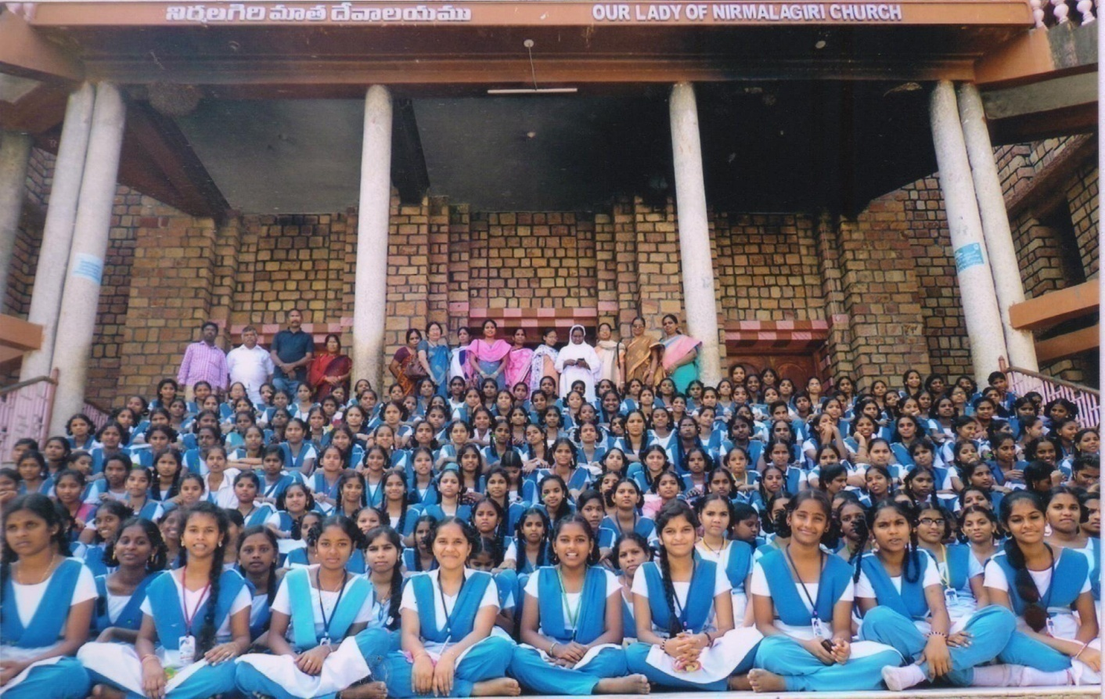
Educational Tour.
We also went to the educational tour to gain the wisdom and knowledge on 17th feb 2018 our Head mistress arranged and accompanied with us to the Nirmala Giri.
200 students and some of our staff visited the place and prayed and offered the mass for the good health and intentions of the students and staff.
We enjoyed whole day and got new strength and encouragement to prepared for the public exam.

Slide 32
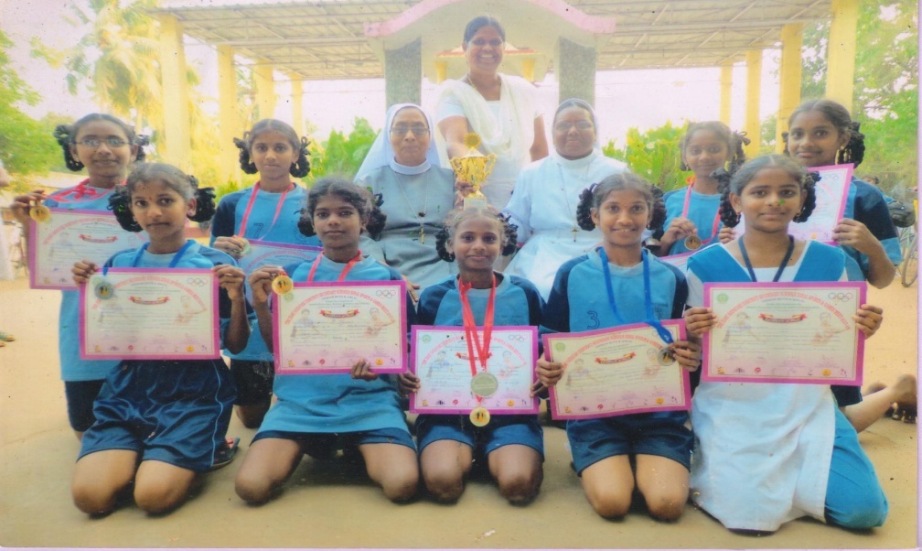
Grigg & Sports Meet.
Grigg & Sports Meeting was held at D.S.A. Grounds on 19.02.2018. The Students of St. Ann’s Aided Girls High School participated in various competitions and won prizes. The Officers of Educational Department appreciated the winners of St. Ann’s Aided Girls High School
100 Mt. Running 2nd place D.S.Suji
200 Mt. Running 2nd place D.S.Suji
200 Mt. Running 3rd place P.Mary
400 Mt. Running 1st place P. Mary
400 Mt. Running 2nd place D.S.Sruji
800 Mt. Running 3rd place R. Jogeeswari
Long Jump 1st Place P. Mary
Long Jump ^{3rd} Place D.S.Sruji
4X100 Relay 1st Place D.S.Sruji
4X100 Relay R. Jogeswari
4X100 Relay T.R. Priyadarshini
4X100 Relay P. Mary
And also won All round championship in Grigg & Sports Meet.

Slide 33
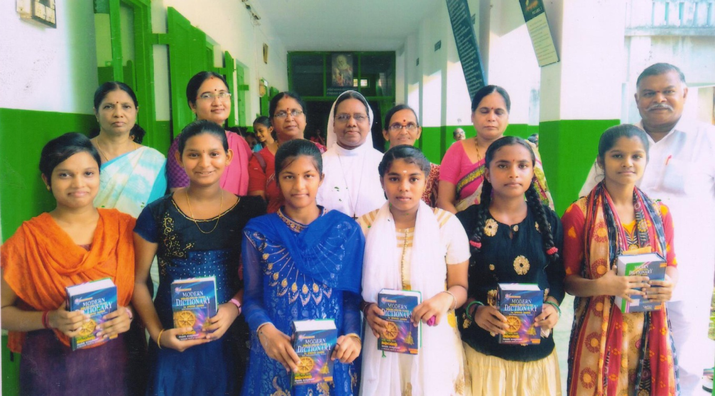
2018 – 19
SSC Result.
In SSC Public Examination March 2018. 180 students from St. Ann’s Aided High School have appeared and 98% result was secured. A. Gnaneswari, V. Navya, K. Amrutha, M. Sandhya Secured 10/10 points and stood in First place.
A .Ramya, T. Bhanu Sri Secured 9.8 points and stood in 2nd place V. Vara Pradha, S.Satya . K. Bhavani, P. Swathi Secured 9.7 Points and stood in 3rd place.

Slide 34
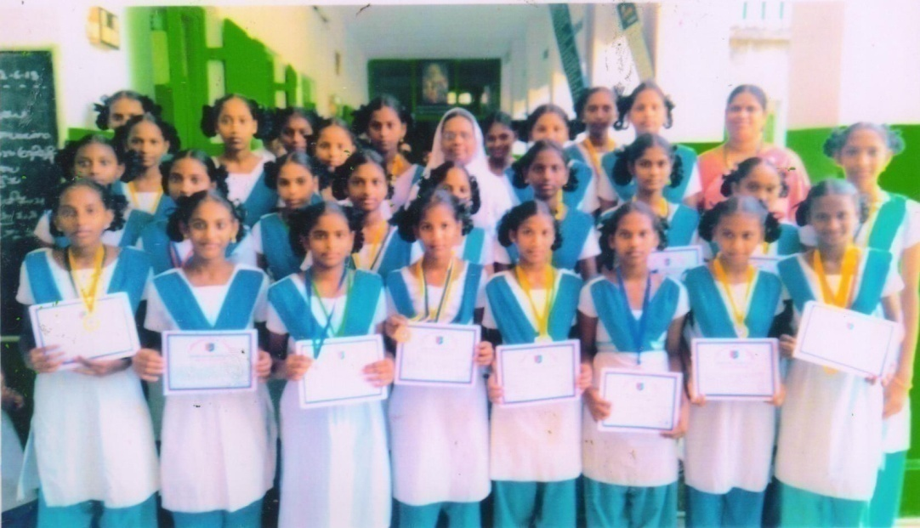
Sports.
Sports Competitions were held in Sri Prakash Engineering College at Tuni From 25.05.18 to 03.06.18. NCC Students of St. Ann’s Aided Girls High School participated in various events and won prizes.
2km Running a) P. Mary b) P. Poornima c) S. Mahalakshmi
Kho-Kho - Winners a) K. Devi b) P. Mary c) P. Poornima d) S. Mahalaxmi e) T. Supriya f) Ch. Charnya g) K. Mounika h) M. Anitha i) M Abhinaya j) Ch.v.v. Lakshmi k) S. Sandhaya.
Drill – First Prize a) k. Bhavani b) MGT Akhila c) V. Vijaya laxmi
d) M. Abhinaya e) M .Anitha f) K. Mounika
g) S. Kranthi h) P Krishnaveni i) Ch.VV Lakshmi
j) K Pvani k) R Rani l)P Ramya
m) B Sodevaki.
4. Solo Dance - First Prize - B. Sodevaki
5. Group Dance- First Prize a) K Devi b) V Meenakshi c) S sandhya
d) V.D.Deepika e) S Mahalaxmi f) B. Sreeveni
6. Firing 2nd Place - Rooth Rani
7. Best CDT - Ch.V.V.Vara lakshmi.

Slide 35
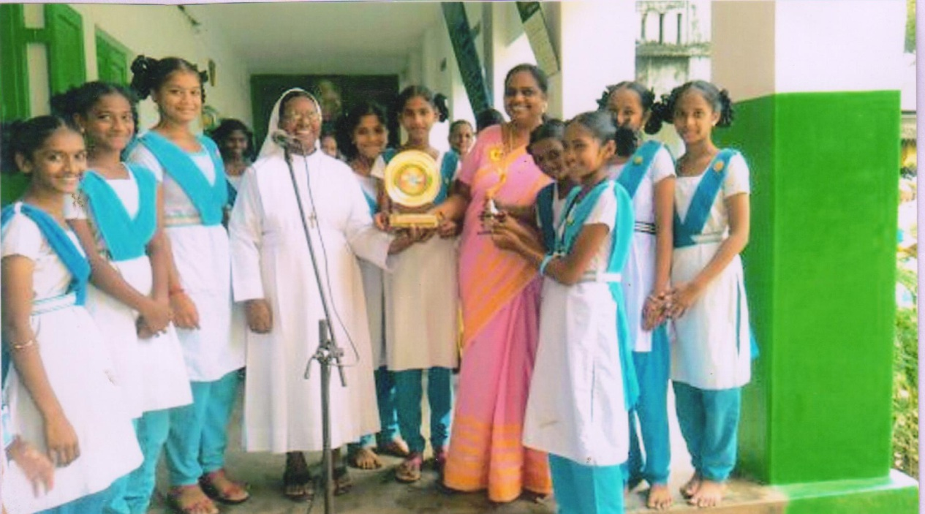
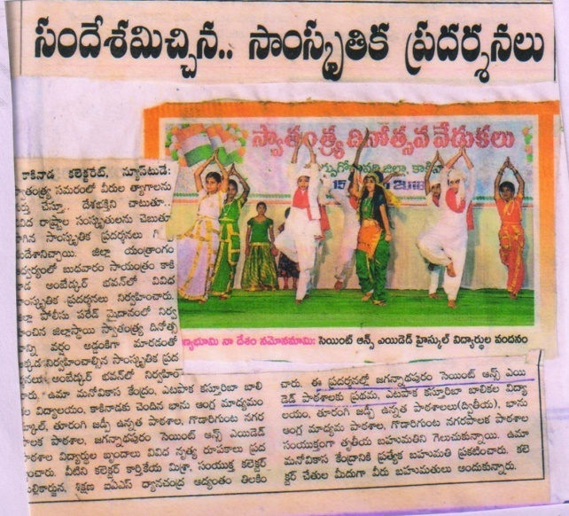
Independence day Celebrations.
Independence Day Celebrations were held at Dist. Police Head Quarter Kakinada on 15.08.18. the students of St. Ann’s Aided Girls High School Participated in cultural activities and won the 1st prize. They received the prize through Deputy Collector and D.E.O.

