Slide 1
ST.JOSEPH OF ANNECY MATRICULATION SCHOOL
No. 16/30, Dr. Ambedkar street,
Villivakkam, chennai – 600 049

Slide 2
SCHOOL BUILDING

Slide 3
sisters of St.Joseph at Villivakkam

Slide 4
KINDER GARTEN PRE.KG
Tiny tots of St. Joseph’s garden

Slide 5
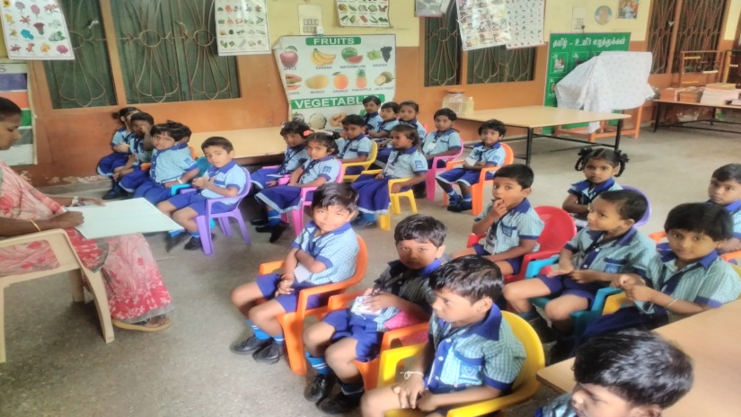
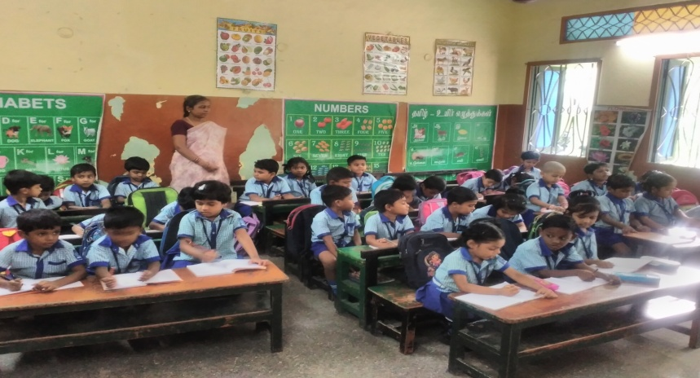
KINDER GARTEN LKG AND UKG

Slide 6
I & II STD
Classroom learning under the able guidance of the Teacher

Slide 7
Extra curricular COMPETITIONS
Elocution
DRAWING

Slide 8
Awareness program
Safe environment
Sex education

Slide 9
Rally - say no to plastic

Slide 10
HEALTH AWARENESS SEMINAR ON NUTRITION

Slide 11
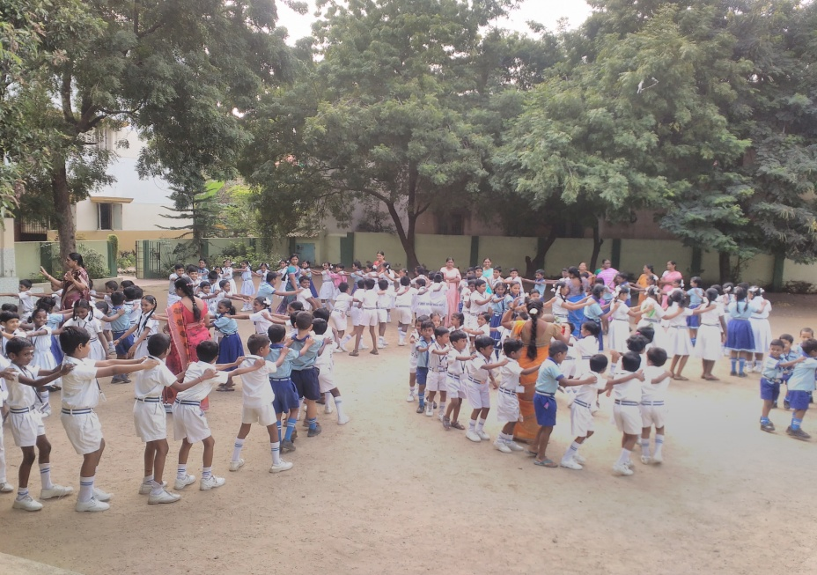
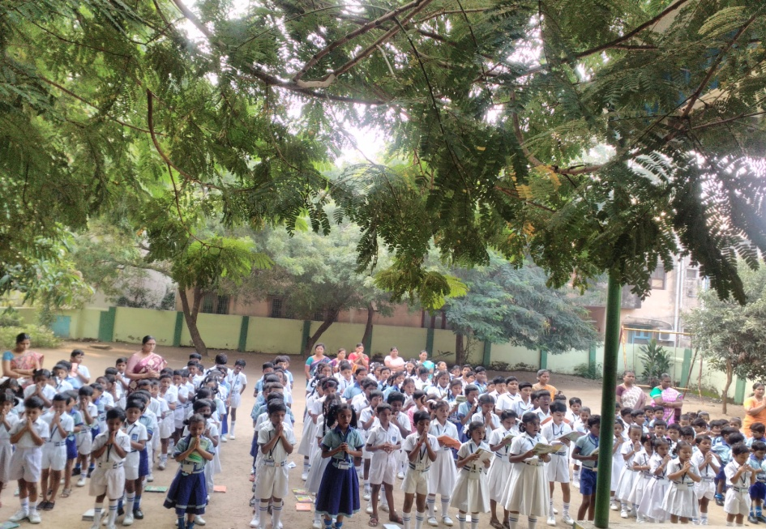

Slide 12
Thank You

